Slide 1

50.039 Theory and Practice of Deep Learning W8-S3 Introduction to Attacks and Defense on Neural Networks
Matthieu De Mari

Slide 2
About this week (Week 8)
What are attacks on Neural Networks (NNs)?
Why are attacks an important concept when studying NNs?
What are the different types of attacks and what is the intuition behind basic attacks?
How to defend against such attacks?
State-of-the-art of (more advanced) attacks and defense, open questions in research.

Slide 3
About this week (Week 8)
What are attacks on Neural Networks (NNs)?
Why are attacks an important concept when studying NNs?
What are the different types of attacks and what is the intuition behind basic attacks?
How to defend against such attacks?
State-of-the-art of (more advanced) attacks and defense, open questions in research.

Slide 4
In the last episode
Exploiting the intrinsic properties/limits of deep learning models allows for powerful attacks with high efficacy and plausibility.
In some cases, we might be able to attack a model with 100% efficacy and very good plausibility.
Can we implement more advanced attacks?
Can we defend against these attacks?
Can attackers respond to such defenses?

Slide 5
About attacks
Basic attacks (discussed in previous lecture):
0. (Epsilon Noising Attack)
Untargeted, one-shot, white-box gradient attack
Untargeted, one-shot, white-box fast gradient sign attack
Untargeted, iterated, white-box fast gradient sign attack
Targeted, one-shot, white-box fast gradient sign attack
Targeted, iterated, white-box fast gradient sign attack

Slide 6
About attacks (and defense!)
Defense strategies against basic attacks:
Arms-race defense
Defensive distillation
Black-boxing your model
More?

Slide 7
About attacks
Advanced attacks (only discussing the concepts briefly, implementation is out of the scope of this class):
Carlini-Wagner attack (targeted, iterated, white-box)
Surrogate attack (targeted/untargeted, one-shot/iterated, black-box)
Boundary attack (targeted, iterated, black-box)
(And, if time allows, a brief state-of-the-art of other remarkable attacks, for curious students!)

Slide 8
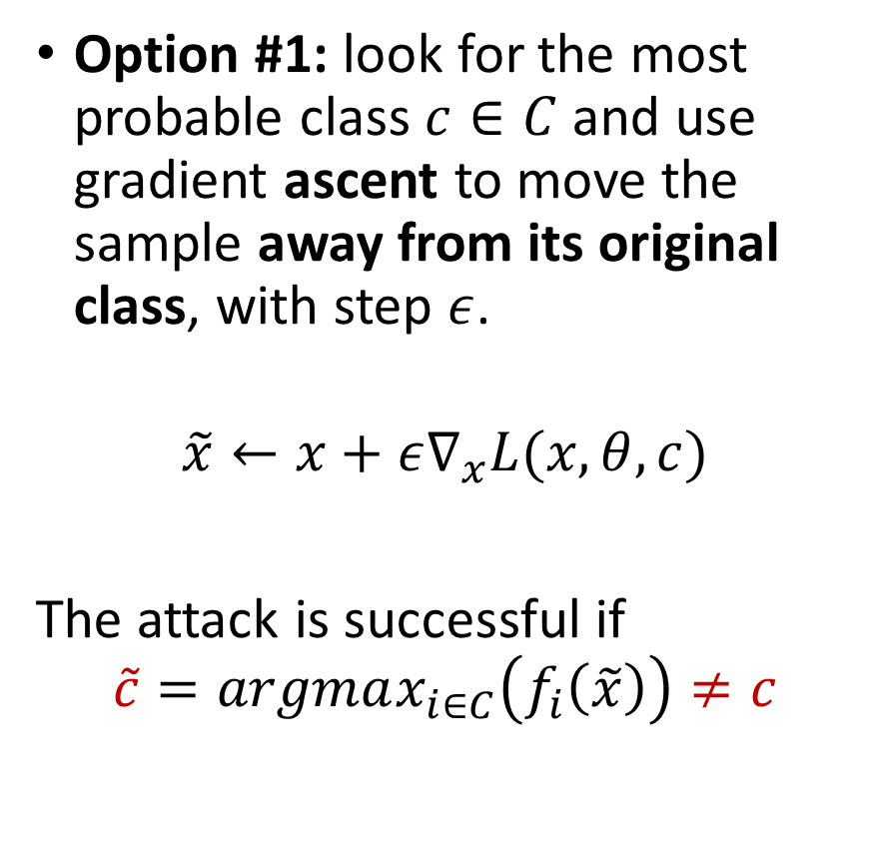
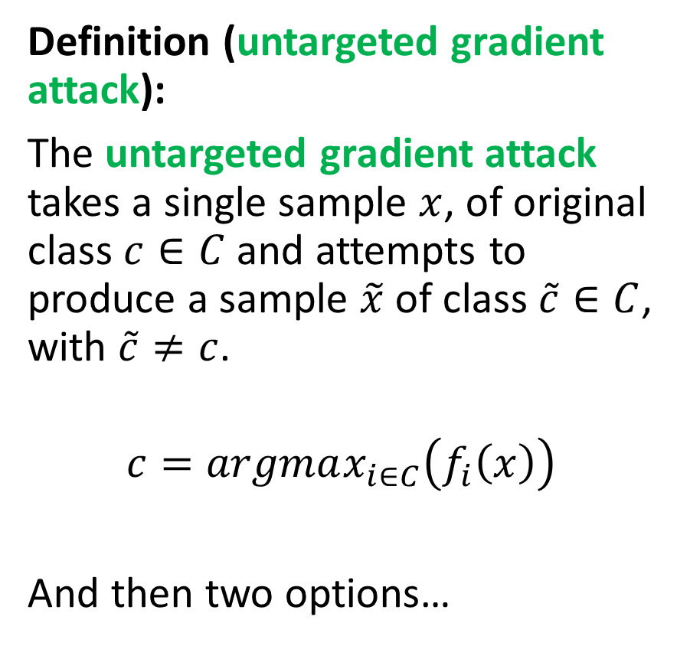
Untargeted Gradient Attack (option #1)
Definition (untargeted gradient attack):
The untargeted gradient attack takes a single sample $x$, of original class $c∈C$ and attempts to produce a sample $\tilde{x}$ of class $\tilde{c}∈C$, with $\tilde{c}≠c$.
$$c=argmax_{i∈C}\left(f_{i}\left(x\right)\right)$$
And then two options…
Option #1: look for the most probable class $c∈C$ and use gradient ascent to move the sample away from its original class, with step $ε$.
$$\tilde{x}←x+ε∇_{x}L(x, θ, c)$$
The attack is successful if
$$\tilde{c}=argmax_{i∈C}\left(f_{i}\left(\tilde{x}\right)\right)≠c$$

Slide 9
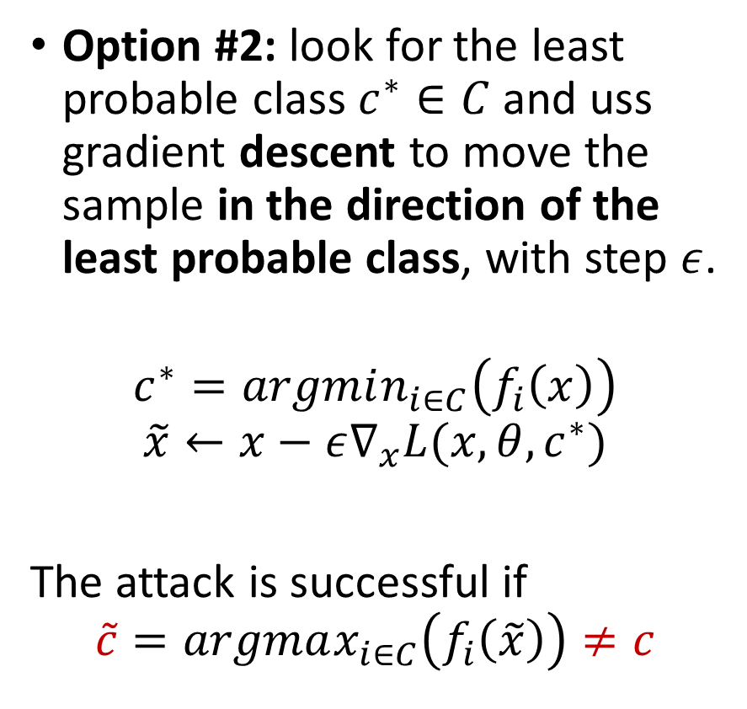
Untargeted Gradient Attack (option #2)
Definition (untargeted gradient attack):
The untargeted gradient attack takes a single sample $x$, of original class $c∈C$ and attempts to produce a sample $\tilde{x}$ of class $\tilde{c}∈C$, with $\tilde{c}≠c$.
$$c=argmax_{i∈C}\left(f_{i}\left(x\right)\right)$$
And then two options…
Option #2: look for the least probable class $c^{∗}∈C$ and uss gradient descent to move the sample in the direction of the least probable class, with step $ε$.
$$c^{∗}=argmin_{i∈C}\left(f_{i}\left(x\right)\right)$$
$$\tilde{x}←x−ε∇_{x}L(x, θ, c^{∗})$$
The attack is successful if
$$\tilde{c}=argmax_{i∈C}\left(f_{i}\left(\tilde{x}\right)\right)≠c$$

Slide 10
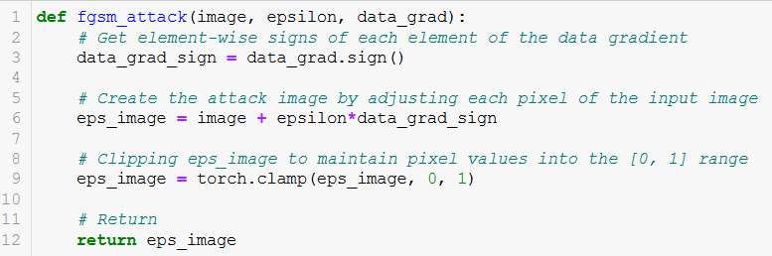
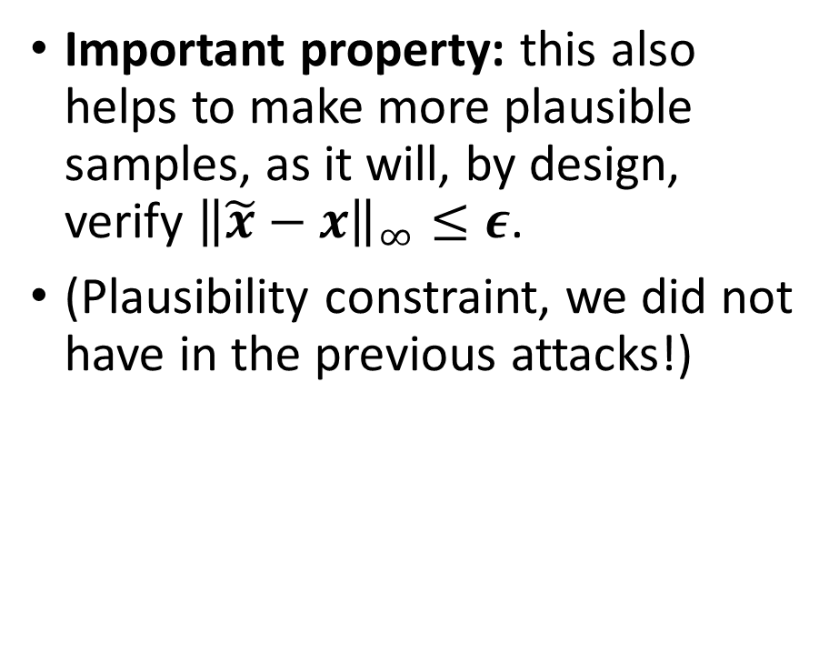
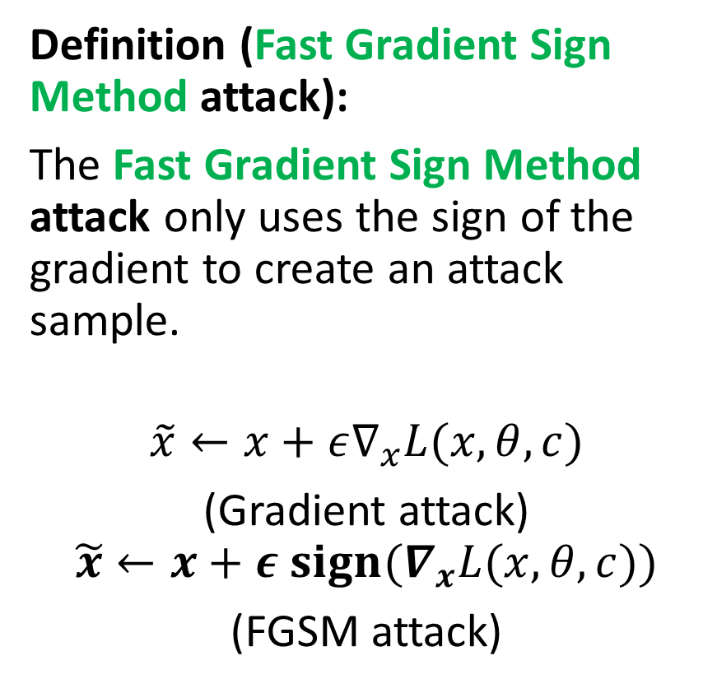
Fast Gradient Sign Method (FGSM)
Definition (Fast Gradient Sign Method attack):
The Fast Gradient Sign Method attack only uses the sign of the gradient to create an attack sample.
$$\tilde{x}←x+ε∇_{x}L(x, θ, c)$$
(Gradient attack)
$$\tilde{x}←x+ε {sign(∇}_{x}L(x, θ, c))$$
(FGSM attack)
Important property: this also helps to make more plausible samples, as it will, by design, verify ${\left\|\tilde{x}−x\right\|}_{∞}≤ε$.
(Plausibility constraint, we did not have in the previous attacks!)

Slide 11
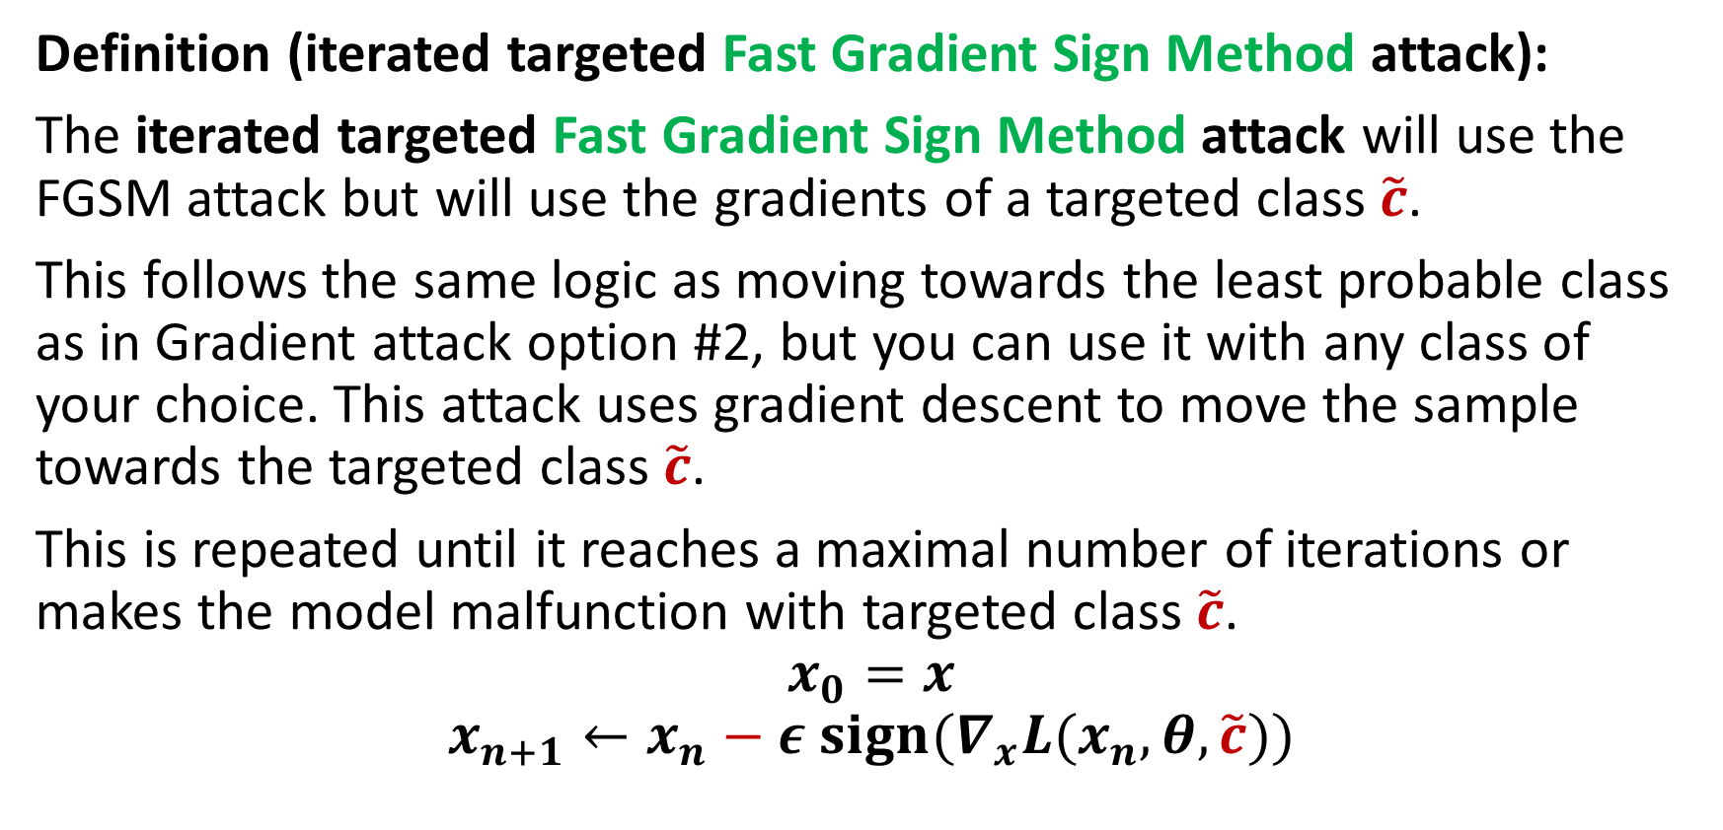
Iterative and Targeted FGSM attack
Definition (iterated targeted Fast Gradient Sign Method attack):
The iterated targeted Fast Gradient Sign Method attack will use the FGSM attack but will use the gradients of a targeted class $\tilde{c}$.
This follows the same logic as moving towards the least probable class as in Gradient attack option #2, but you can use it with any class of your choice. This attack uses gradient descent to move the sample towards the targeted class $\tilde{c}$.
This is repeated until it reaches a maximal number of iterations or makes the model malfunction with targeted class $\tilde{c}$.
$$x_{0}=x$$
$$x_{n+1}←x_{n}−ε {sign(∇}_{x}L(x_{n}, θ,\tilde{c}))$$

Slide 12

The arms race defense
Definition (the arms race defense):
The arms race defense strategy, is the most basic defense strategy.
If we know the type of attack that is coming, we can generate our own attack samples and train our model to correctly classify some of these attack samples.
And therefore anticipate for future attacks of this type.
Attackers
Defenders
Attackers
Defenders
Attackers
Defenders
Attackers
Defenders
Defenders
Attackers
Source: https://explosm.net/comics/3939/

Slide 13
The Madry’s (or arms race) defense
Definition (the Madry’s (or arms race) defense):
The arms race defense strategy, is the most basic defense strategy.
If we know the type of attack that is coming, we can generate our own attack samples and train our model to correctly classify some of these attack samples.
And therefore anticipate for future attacks of this type.
Attackers
Defenders
Attackers
Defenders
Attackers
Defenders
Attackers
Defenders
Defenders
Attackers
Source: https://explosm.net/comics/3939/
Note: this is also known as the Madry’s defense [Madry2017].

Slide 14
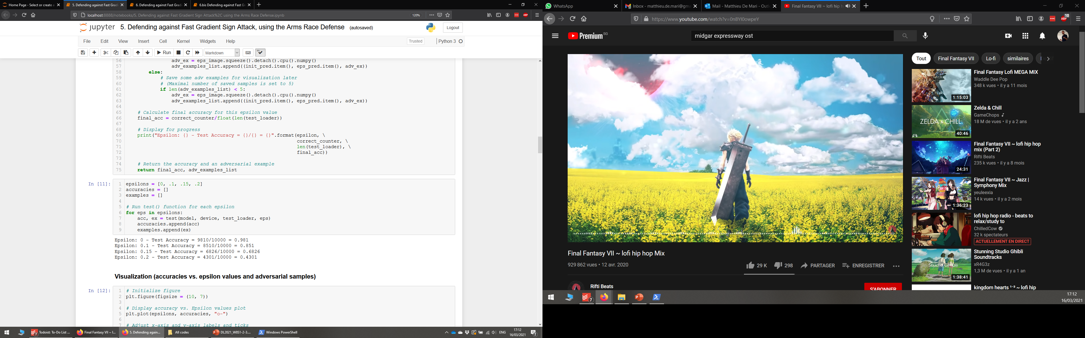
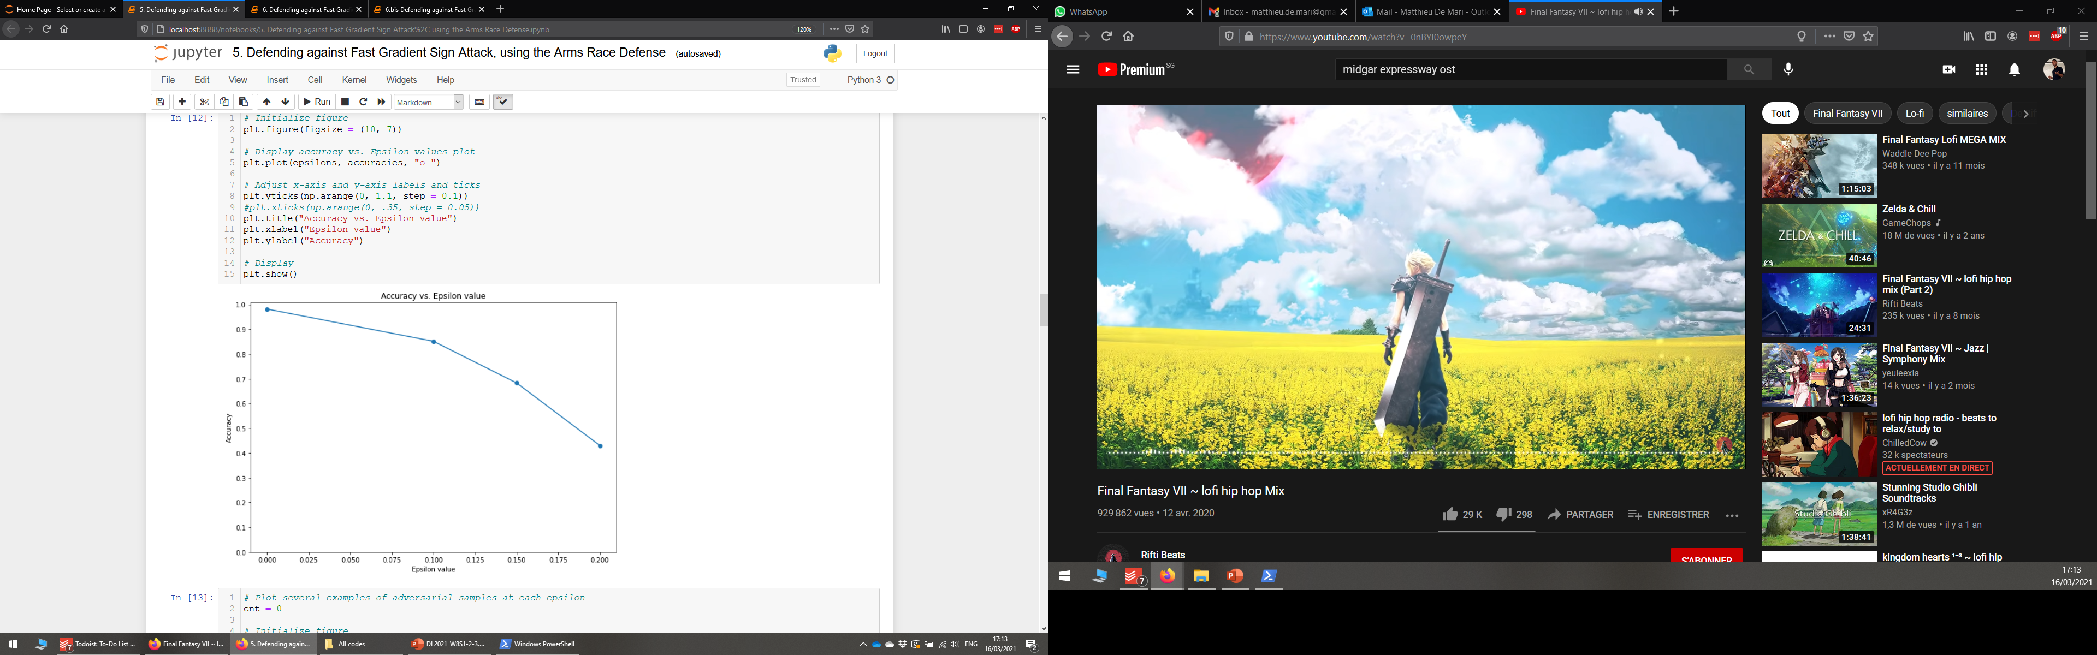
The arms race defense
Let us start with our pre-trained model, and the basic FGSM attack (one-shot, untargeted version).
Our model is not prepared to face this type of attacks and will suffer badly from it.

Slide 15
The arms race defense
Our next step would then be to continue the training of our model, integrating samples that have been generated using said FGSM attack.
Intuition: in a sense, the arms race defense is a sort of data augmentation technique, that helps make the model more robust to attacks of the FGSM type.

Slide 16
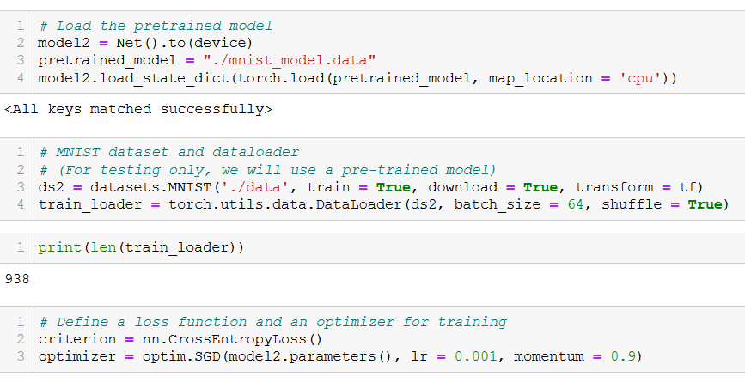
The arms race defense
For demonstration, we will create a second model, using the same pre-trained weights.
We will also retrieve the training dataset and make its dataloader (train_loader), with mini-batches.
We will then continue the training of this model, using CrossEntropy as our loss and a basic SGD as our optimizer.
From Notebook 5.!

Slide 17
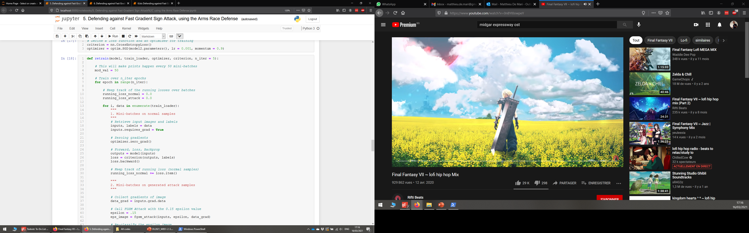
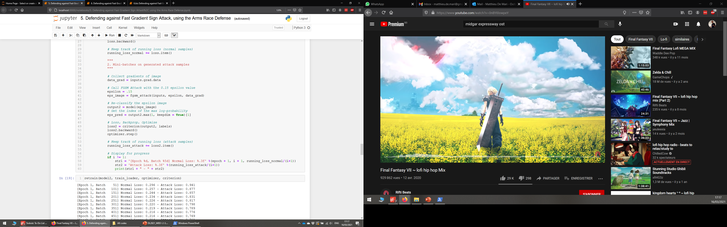
Retraining our model

Slide 18
Retraining our model
Just like in “normal” training we are going to train on the training samples (this uses our train_loader, not the test one!)

Slide 19
Retraining our model
And in the second part, we will do the same, but will transform the samples using our attack function and train on this sample.

Slide 20
Retraining our model
In addition (not shown here), we will display the running losses for both the normal and attack samples.

Slide 21
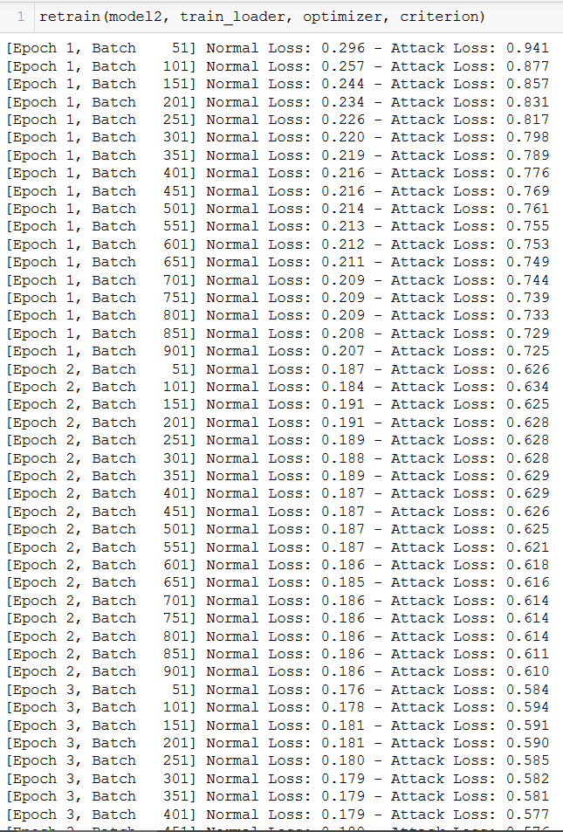
The arms race defense
Retraining will not necessarily affect the loss on normal samples (it will keep on decreasing, possibly overfitting, but this should not change the accuracy performance of the model on normal samples).
What is important: we are able to train to recognize attack samples and our model progressively becomes better at it.

Slide 22
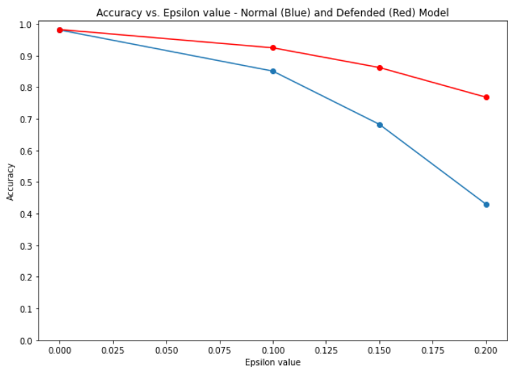
The arms race defense
Training on the attack samples then makes the model a bit more robust to this type of attacks.
In blue, you have the original model (undefended). In red, the defended model.
Conclusion: Both of them have the same baseline accuracy, but the second model seems to resist more to the FGSM attacks
(Can be improved with more training than 5 iterations!)

Slide 23
The Madry’s (or arms race) defense
Definition (the Madry’s (or arms race) defense):
The arms race defense strategy, is the most basic defense strategy.
If we know the type of attack that is coming, we can generate our own attack samples and train our model to correctly classify some of these attack samples.
And therefore anticipate for future attacks of this type.
Attackers
Defenders
Attackers
Defenders
Attackers
Defenders
Attackers
Defenders
Defenders
Attackers
Source: https://explosm.net/comics/3939/
Note: this is also known as the Madry’s defense [Madry2017].

Slide 24
The arms race defense
While this is the most intuitive approach and might work on the type of attacks you train your model for…
This defense strategy will ultimately be defeated by attackers, who just have to implement a new type of attack…
And your model simply will not know how to handle it.
For instance, here, we defended against FGSM, but the Gradient attack remains undefended.

Slide 25
The arms race defense
While this is the most intuitive approach and might work on the type of attacks you train your model for…
This defense strategy will ultimately be defeated by attackers, who just have to implement a new type of attack…
And your model simply will not know how to handle it.
For instance, here, we defended against FGSM, but the Gradient attack remains undefended.
And attackers these days are getting pretty creative with new types of attacks!
There are even challenges/competitions for coming up with new attacks against “defended” systems!
See [Medium1] and [Dong2017].

Slide 26
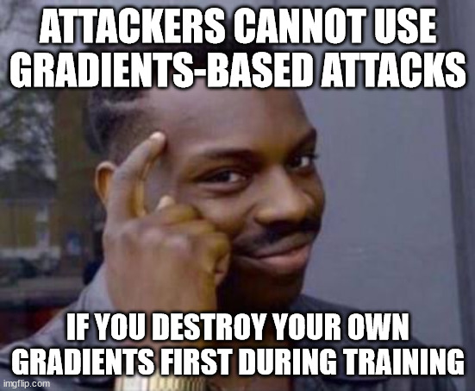
Defensive distillation
Core idea behind gradient-based defensive distillation.
Most gradient-based attacks rely on the gradients to compute an attack sample.
If we were to annihilate these gradients, the attackers would not be able to produce attack samples.

Slide 27
Defensive distillation
Core idea behind gradient-based defensive distillation.
Most gradient-based attacks rely on the gradients to compute an attack sample.
If we were to annihilate these gradients, the attackers would not be able to produce attack samples.
Note that this is a pretty risky strategy, as you need those gradients during the training phase of your model!
Defensive distillation will however do so, by using some of the softmax function properties.
Idea comes from [Papernot2015].

Slide 28
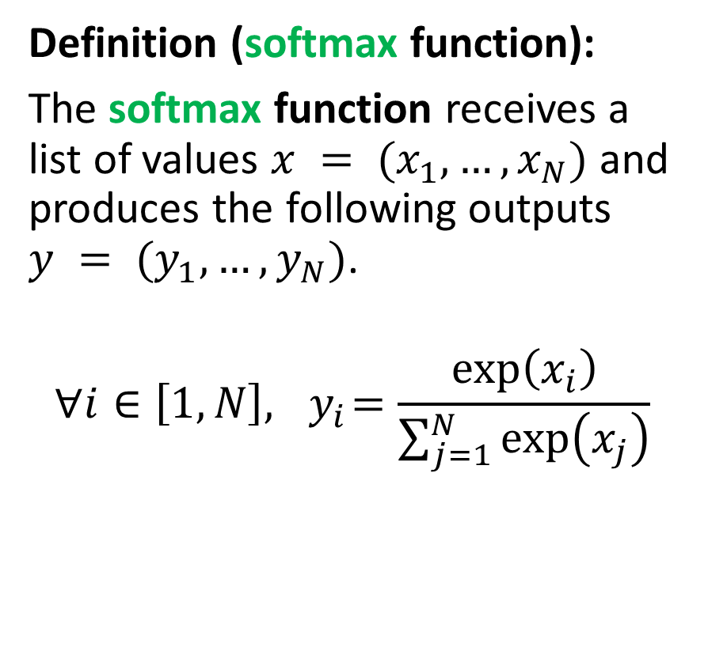
Reminder: the softmax function
Definition (softmax function):
The softmax function receives a list of values $x = (x_{1}, …, x_{N})$and produces the following outputs $y = (y_{1}, …, y_{N})$.
$$∀i∈\left[1, N\right], { y}_{i}=\frac{\exp\left(x_{i}\right)}{\sum_{j=1}^{N}{\exp\left(x_{j}\right)}}$$

Slide 29
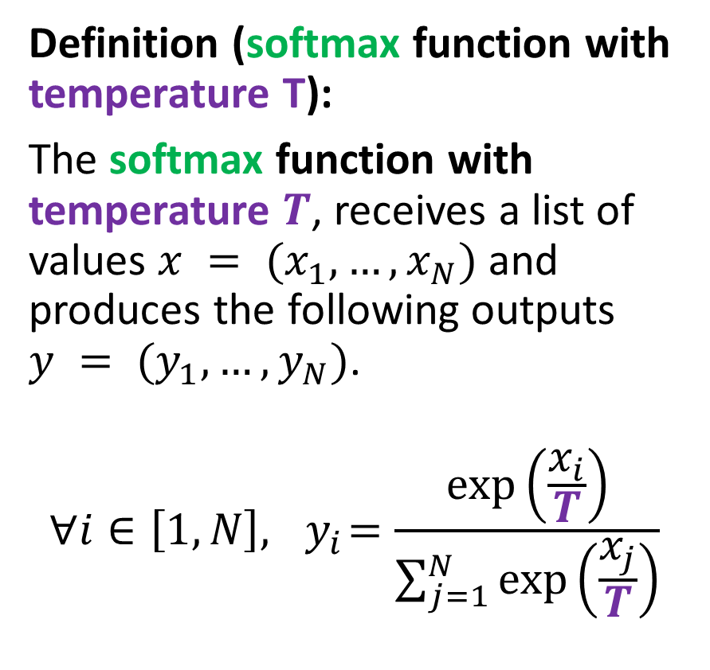
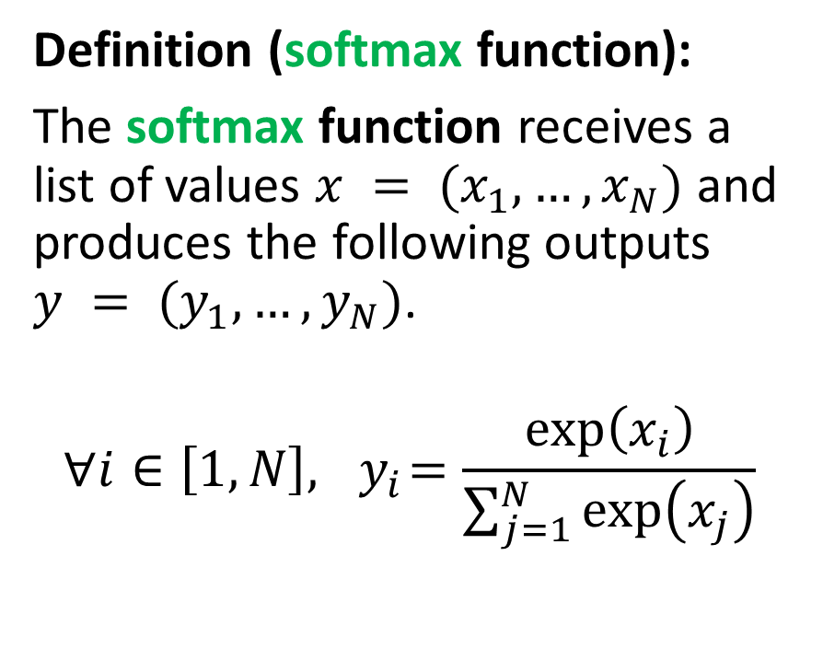
Reminder: the softmax function
Definition (softmax function):
The softmax function receives a list of values $x = (x_{1}, …, x_{N})$and produces the following outputs $y = (y_{1}, …, y_{N})$.
$$∀i∈\left[1, N\right], { y}_{i}=\frac{\exp\left(x_{i}\right)}{\sum_{j=1}^{N}{\exp\left(x_{j}\right)}}$$
Definition (softmax function with temperature T):
The softmax function with temperature $T$, receives a list of values $x = (x_{1}, …, x_{N})$and produces the following outputs $y = (y_{1}, …, y_{N})$.
$$∀i∈\left[1, N\right], { y}_{i}=\frac{\exp\left(\frac{x_{i}}{T}\right)}{\sum_{j=1}^{N}{\exp\left(\frac{x_{j}}{T}\right)}}$$

Slide 30
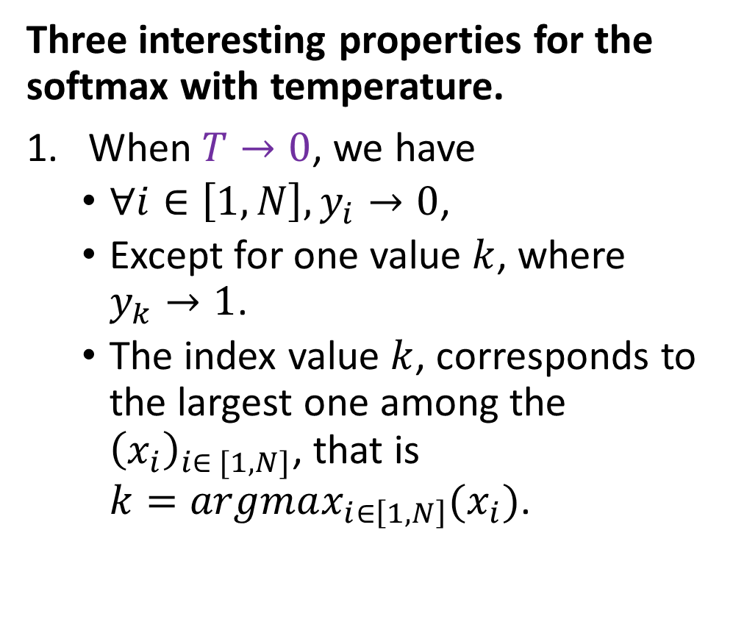
The softmax function (with temperature T)
Definition (softmax function with temperature T):
The softmax function with temperature $T$, receives a list of values $x = (x_{1}, …, x_{N})$and produces the following outputs $y = (y_{1}, …, y_{N})$.
$$∀i∈\left[1, N\right], { y}_{i}=\frac{\exp\left(\frac{x_{i}}{T}\right)}{\sum_{j=1}^{N}{\exp\left(\frac{x_{j}}{T}\right)}}$$
Three interesting properties for the softmax with temperature.
When $T→0$, we have
$∀i∈\left[1,N\right], y_{i}→0$,
Except for one value $k$, where $y_{k}→1$.
The index value $k$, corresponds to the largest one among the ${\left(x_{i}\right)}_{i∈ [1, N]}$, that is $k=argmax_{i∈\left[1, N\right]}(x_{i})$.

Slide 31
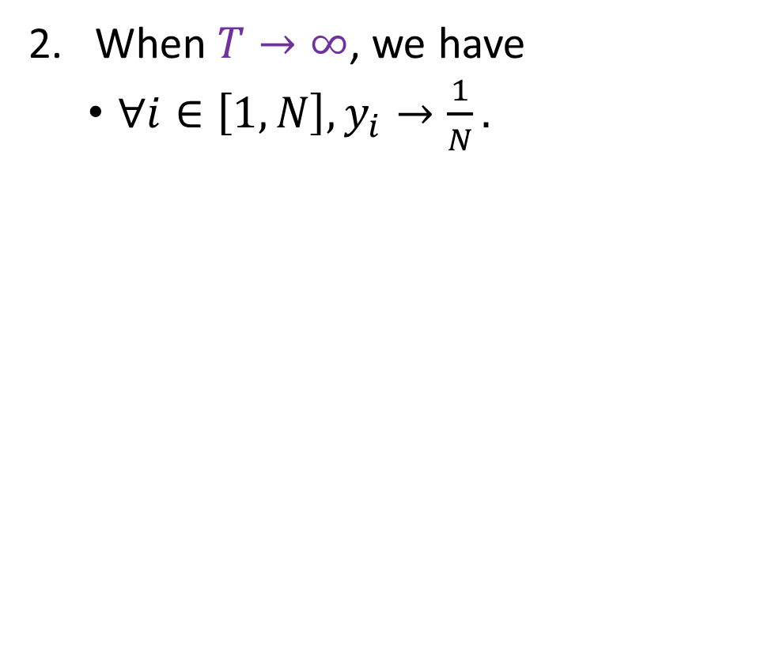
The softmax function (with temperature T)
Definition (softmax function with temperature T):
The softmax function with temperature $T$, receives a list of values $x = (x_{1}, …, x_{N})$and produces the following outputs $y = (y_{1}, …, y_{N})$.
$$∀i∈\left[1, N\right], { y}_{i}=\frac{\exp\left(\frac{x_{i}}{T}\right)}{\sum_{j=1}^{N}{\exp\left(\frac{x_{j}}{T}\right)}}$$
When $T→∞$, we have
$∀i∈\left[1,N\right], y_{i}→\frac{1}{N}.$

Slide 32
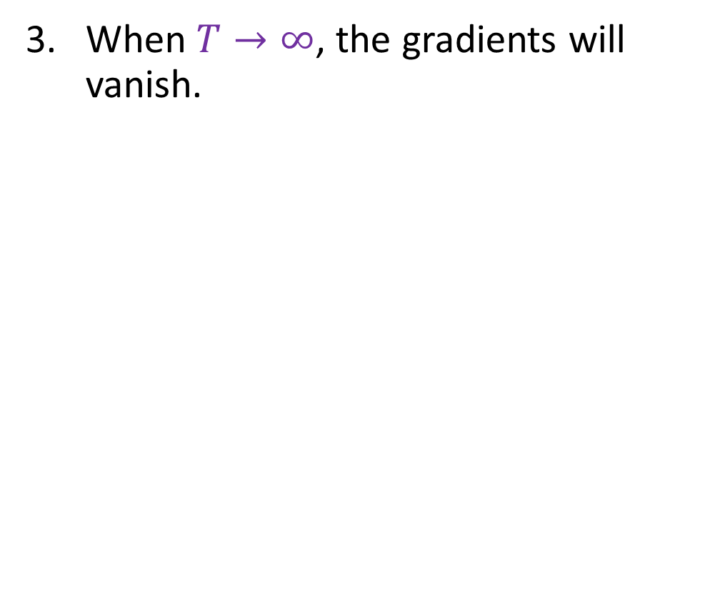
The softmax function (with temperature T)
Definition (softmax function with temperature T):
The softmax function with temperature $T$, receives a list of values $x = (x_{1}, …, x_{N})$and produces the following outputs $y = (y_{1}, …, y_{N})$.
$$∀i∈\left[1, N\right], { y}_{i}=\frac{\exp\left(\frac{x_{i}}{T}\right)}{\sum_{j=1}^{N}{\exp\left(\frac{x_{j}}{T}\right)}}$$
When $T→∞$, the gradients will vanish.

Slide 33
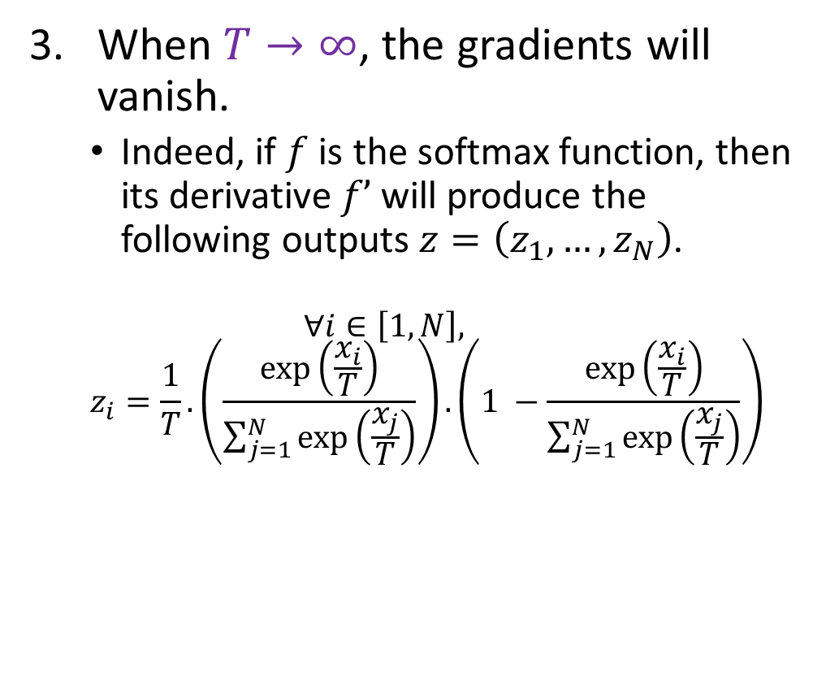
The softmax function (with temperature T)
Definition (softmax function with temperature T):
The softmax function with temperature $T$, receives a list of values $x = (x_{1}, …, x_{N})$and produces the following outputs $y = (y_{1}, …, y_{N})$.
$$∀i∈\left[1, N\right], { y}_{i}=\frac{\exp\left(\frac{x_{i}}{T}\right)}{\sum_{j=1}^{N}{\exp\left(\frac{x_{j}}{T}\right)}}$$
When $T→∞$, the gradients will vanish.
Indeed, if $f$ is the softmax function, then its derivative $f’$will produce the following outputs $z=\left(z_{1},…,z_{N}\right)$.
$$∀i∈\left[1,N\right],$$
$$z_{i}=\frac{1}{T}.\left(\frac{\exp\left(\frac{x_{i}}{T}\right)}{\sum_{j=1}^{N}{\exp\left(\frac{x_{j}}{T}\right)}}\right).\left(1 −\frac{\exp\left(\frac{x_{i}}{T}\right)}{\sum_{j=1}^{N}{\exp\left(\frac{x_{j}}{T}\right)}}\right)$$

Slide 34
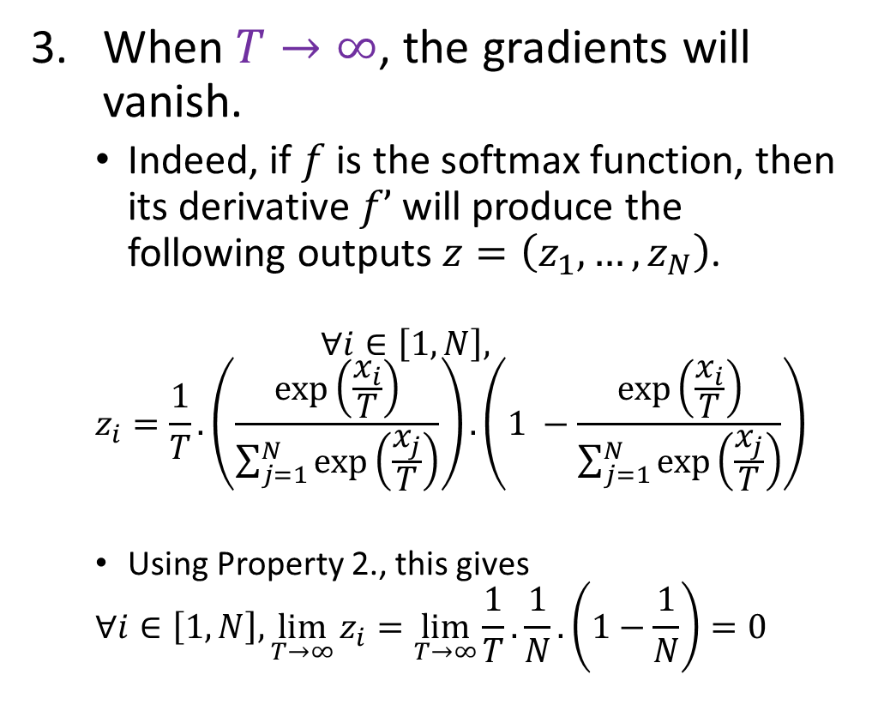
The softmax function (with temperature T)
Definition (softmax function with temperature T):
The softmax function with temperature $T$, receives a list of values $x = (x_{1}, …, x_{N})$and produces the following outputs $y = (y_{1}, …, y_{N})$.
$$∀i∈\left[1, N\right], { y}_{i}=\frac{\exp\left(\frac{x_{i}}{T}\right)}{\sum_{j=1}^{N}{\exp\left(\frac{x_{j}}{T}\right)}}$$
When $T→∞$, the gradients will vanish.
Indeed, if $f$ is the softmax function, then its derivative $f’$will produce the following outputs $z=\left(z_{1},…,z_{N}\right)$.
$$∀i∈\left[1,N\right],$$
$$z_{i}=\frac{1}{T}.\left(\frac{\exp\left(\frac{x_{i}}{T}\right)}{\sum_{j=1}^{N}{\exp\left(\frac{x_{j}}{T}\right)}}\right).\left(1 −\frac{\exp\left(\frac{x_{i}}{T}\right)}{\sum_{j=1}^{N}{\exp\left(\frac{x_{j}}{T}\right)}}\right)$$
Using Property 2., this gives
$$∀i∈\left[1,N\right], \lim_{T→∞}{z_{i}=\lim_{T→∞}\frac{1}{T}.\frac{1}{N}}.\left(1−\frac{1}{N}\right)=0$$

Slide 35
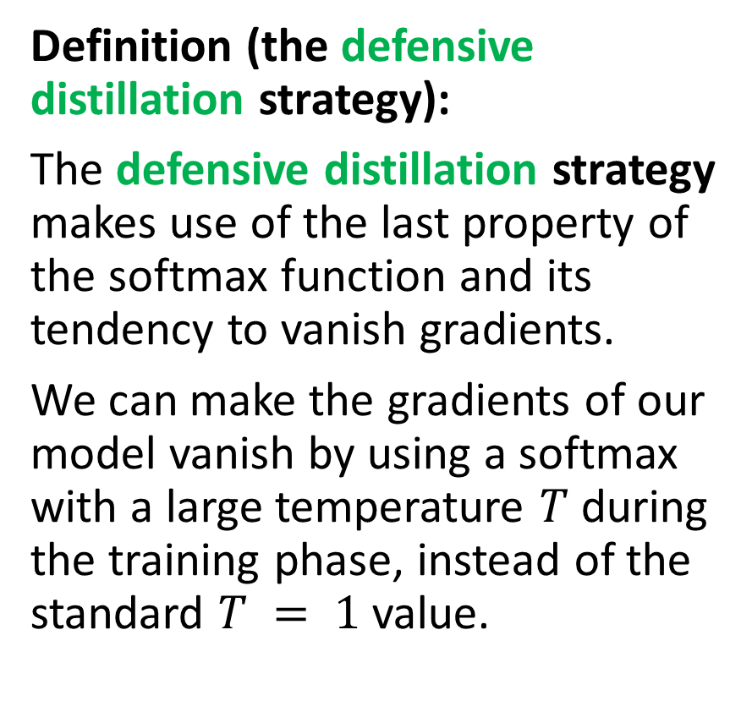
The defensive distillation strategy
Definition (the defensive distillation strategy):
The defensive distillation strategy makes use of the last property of the softmax function and its tendency to vanish gradients.
We can make the gradients of our model vanish by using a softmax with a large temperature $T$ during the training phase, instead of the standard $T = 1$value.

Slide 36

The defensive distillation strategy
Definition (the defensive distillation strategy):
The defensive distillation strategy makes use of the last property of the softmax function and its tendency to vanish gradients.
We can make the gradients of our model vanish by using a softmax with a large temperature $T$ during the training phase, instead of the standard $T = 1$value.
This will make the gradients vanish, and they might no longer be usable by the attackers for the gradient and fast gradient sign attacks.
Important: It might however complicate the training of the model! (Remember that we need these gradients to train and backpropagate!)

Slide 37
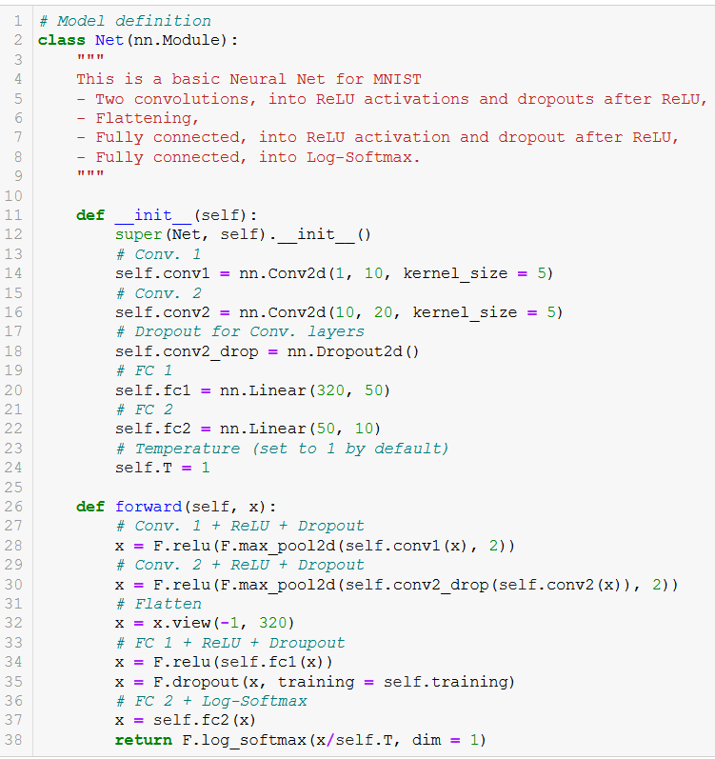
Model changes
We will first change the constructor of our model, and add a temperature T.

Slide 38
Model changes
We will first change the constructor of our model, and add a temperature T.
This temperature is then used in the softmax function of the forward() method.

Slide 39
Model changes
We will first change the constructor of our model, and add a temperature T.
This temperature is then used in the softmax function of the forward() method.
It can later be changed using model.T = new_value

Slide 40
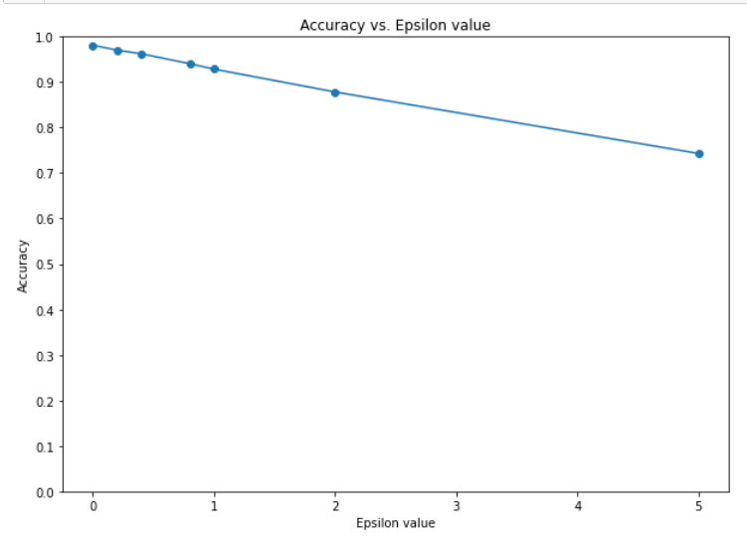
Original model for baseline
In Notebook 6., we will be using our original model and the Gradient-based attack for reference.
This is our efficacy vs. epsilon graph for the undefended model.

Slide 41
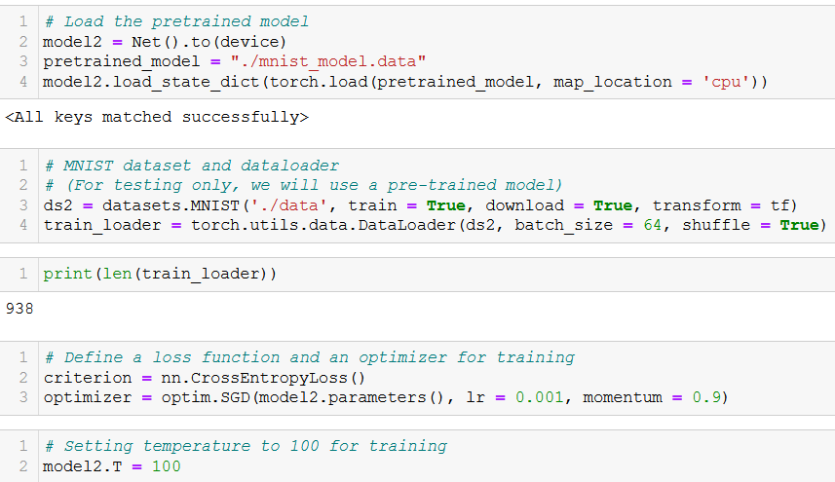
Defended model
The defended model, used for comparison will be a copy of the undefended model.

Slide 42
Defended model
The defended model, used for comparison will be a copy of the undefended model.
We will then change the temperature to T = 100 (arbitrarily chosen).

Slide 43
Defended model
The defended model, used for comparison will be a copy of the undefended model.
We will then change the temperature to T = 100 (arbitrarily chosen).
And will continue the training of this model on the training set, with this new “high” temperature.

Slide 44
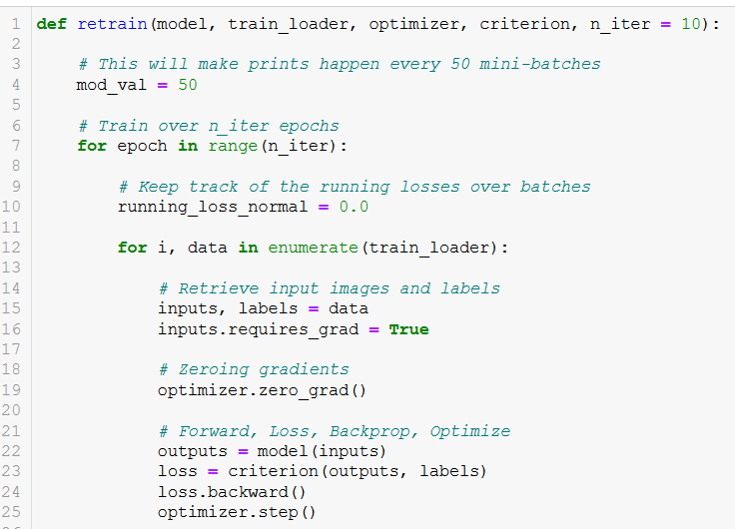
Defended model
The defended model, used for comparison will be a copy of the undefended model.
We will then change the temperature to T = 100 (arbitrarily chosen).
And will continue the training of this model on the training set, with this new “high” temperature.

Slide 45
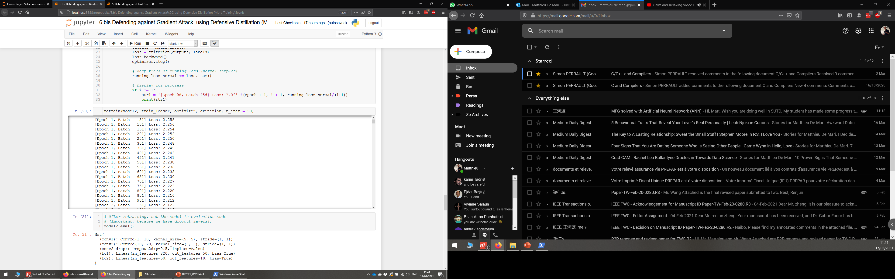
Defended model
The defended model, used for comparison will be a copy of the undefended model.
We will then change the temperature to T = 100 (arbitrarily chosen).
If we want, we can continue the training of this model, with this new “high” temperature, to check it leads to very little changes in model parameters (gradients are close to zero)

Slide 46
Defended model
The defended model, used for comparison will be a copy of the undefended model.
We will then change the temperature to T = 100 (arbitrarily chosen).
If we want, we can continue the training of this model, with this new “high” temperature, to check it leads to very little changes in model parameters (gradients are close to zero)

Slide 47
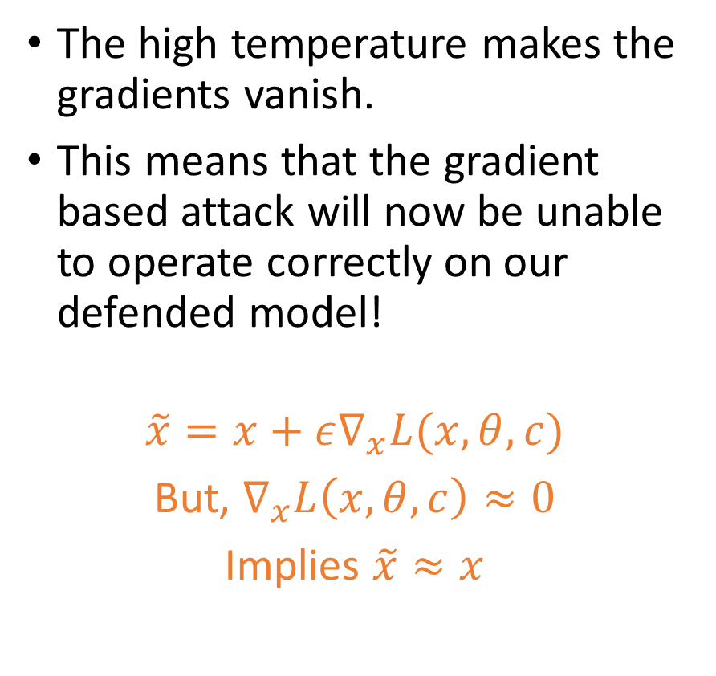
Defended model performance
The high temperature makes the gradients vanish.
This means that the gradient based attack will now be unable to operate correctly on our defended model!
$$\tilde{x}=x+ε∇_{x}L(x, θ, c)$$
But, $∇_{x}L\left(x, θ, c\right)≈0$
Implies $\tilde{x}≈x$

Slide 48
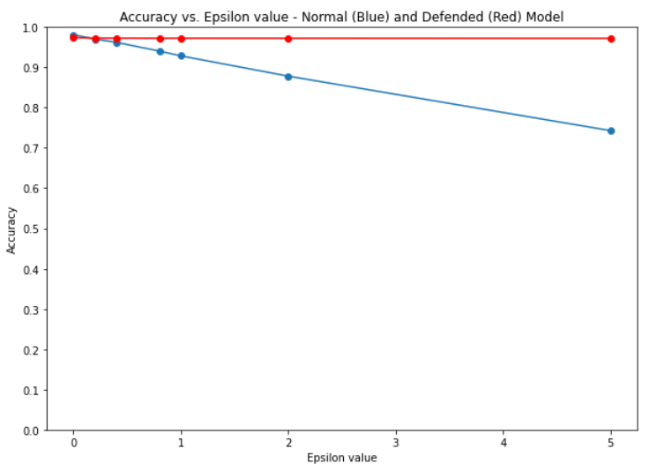
Defended model performance
The high temperature makes the gradients vanish.
This means that the gradient based attack will now be unable to operate correctly on our defended model!
$$\tilde{x}=x+ε∇_{x}L(x, θ, c)$$
But, $∇_{x}L\left(x, θ, c\right)≈0$
Implies $\tilde{x}≈x$

Slide 49
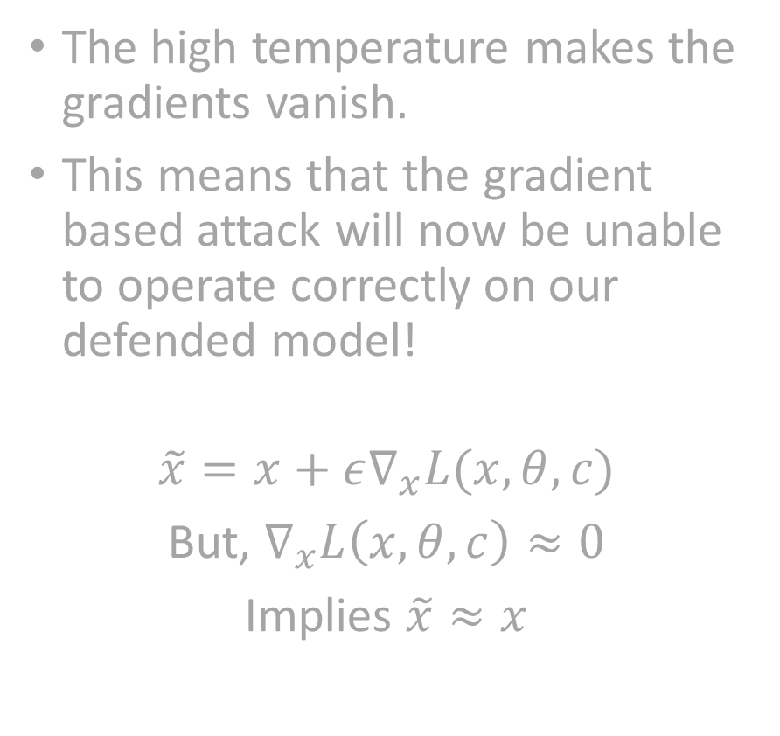
Defended model performance
The high temperature makes the gradients vanish.
This means that the gradient based attack will now be unable to operate correctly on our defended model!
$$\tilde{x}=x+ε∇_{x}L(x, θ, c)$$
But, $∇_{x}L\left(x, θ, c\right)≈0$
Implies $\tilde{x}≈x$
Open question…
Will defensive distillation work on the FGSM attack, which only uses the SIGN of the gradient?

Slide 50
The current state of our defenses against white-box models
So far, defenders have only two options to defend against gradient-based attacks.
Either train specifically in anticipation for these attacks (and we have seen it works quite well on FGSM attacks).
Or make the gradients vanish to mess with the attackers (and we have seen it works quite well on gradient-based attacks).

Slide 51
The current state of our defenses against white-box models
So far, defenders have only two options to defend against gradient-based attacks.
Either train specifically in anticipation for these attacks (and we have seen it works quite well on FGSM attacks).
Or make the gradients vanish to mess with the attackers (and we have seen it works quite well on gradient-based attacks).
That should be good enough, right?

Slide 52
The current state of our defenses against white-box models
So far, defenders have only two options to defend against gradient-based attacks.
Either train specifically in anticipation for these attacks (and we have seen it works quite well on FGSM attacks).
Or make the gradients vanish to mess with the attackers (and we have seen it works quite well on gradient-based attacks).
That should be good enough, right?
I mean, there is now way for attackers to come up with something else, to attack my model, right?

Slide 53
Carlini-Wagner attack (targeted, iterated, white-box)
The Carlini-Wagner attack is a targeted, (one-shot or) iterated, white-box attack [Carlini2017].

Slide 54
Carlini-Wagner attack (targeted, iterated, white-box)
The Carlini-Wagner attack is a targeted, (one-shot or) iterated, white-box attack [Carlini2017].
It uses some of the model properties to perform create adversarial samples.
It does not use the gradients…
It uses the logits of the model instead.
This means that the defensive distillation or the arms race defense will not work against this attack.

Slide 55
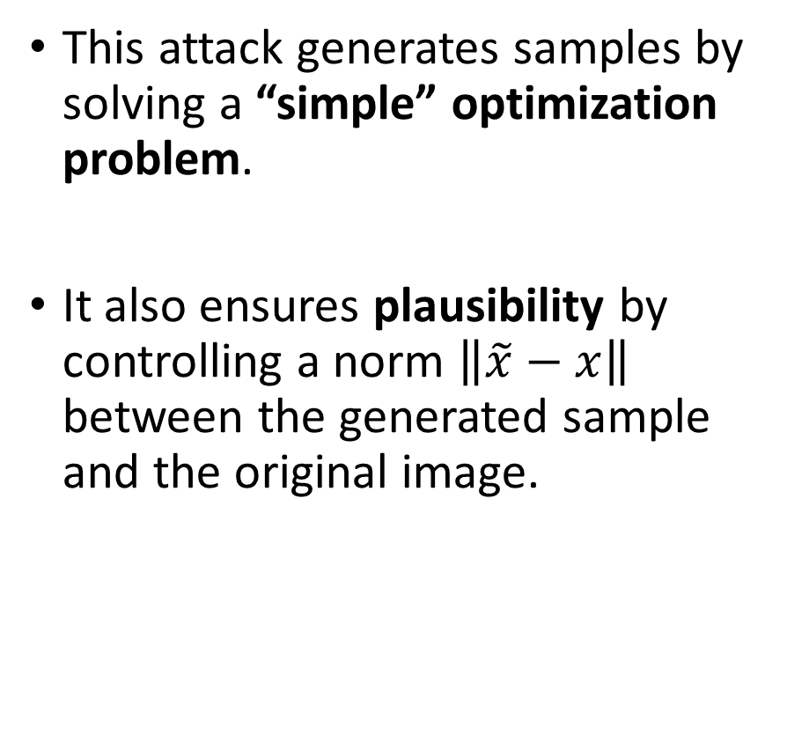
Carlini-Wagner attack (targeted, iterated, white-box)
The Carlini-Wagner attack is a targeted, (one-shot or) iterated, white-box attack [Carlini2017].
It uses some of the model properties to perform create adversarial samples.
It does not use the gradients…
It uses the logits of the model instead.
This means that the defensive distillation or the arms race defense will not work against this attack.
This attack generates samples by solving a “simple” optimization problem.
It also ensures plausibility by controlling a norm $\left\|\tilde{x}−x\right\|$ between the generated sample and the original image.

Slide 56
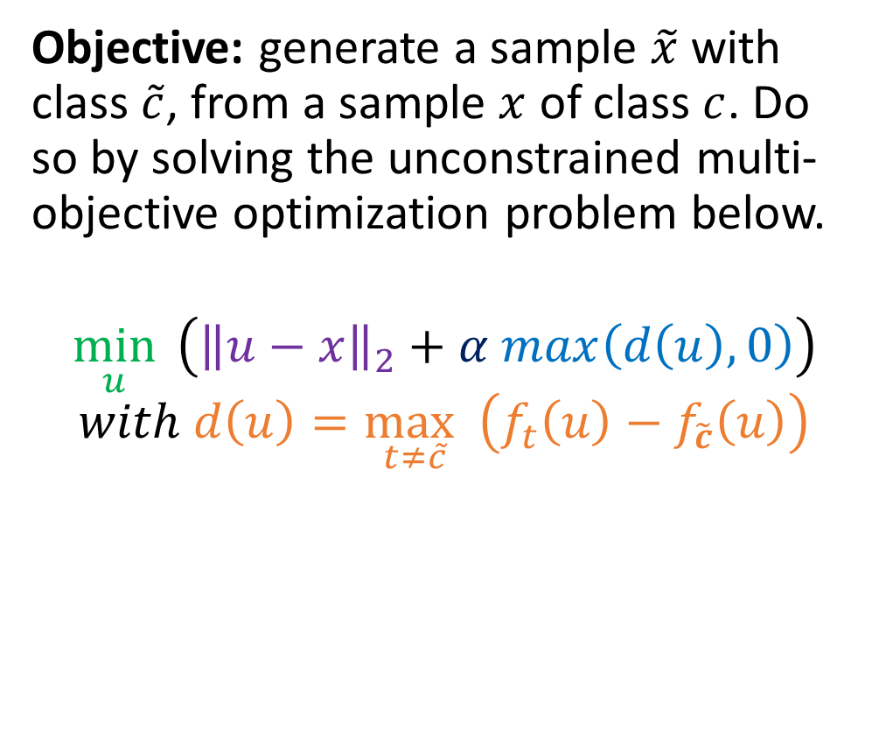
Carlini-Wagner optimization
Objective: generate a sample $\tilde{x}$ with class $\tilde{c}$, from a sample $x$ of class $c$. Do so by solving the unconstrained multi-objective optimization problem below.
$$\min_{u}{ \left({\left\|u−x\right\|}_{2}+α max\left(d\left(u\right), 0\right)\right)}$$
$$with d\left(u\right)=\max_{t≠\tilde{c}} \left(f_{t}\left(u\right)−f_{\tilde{c}}\left(u\right)\right)$$

Slide 57
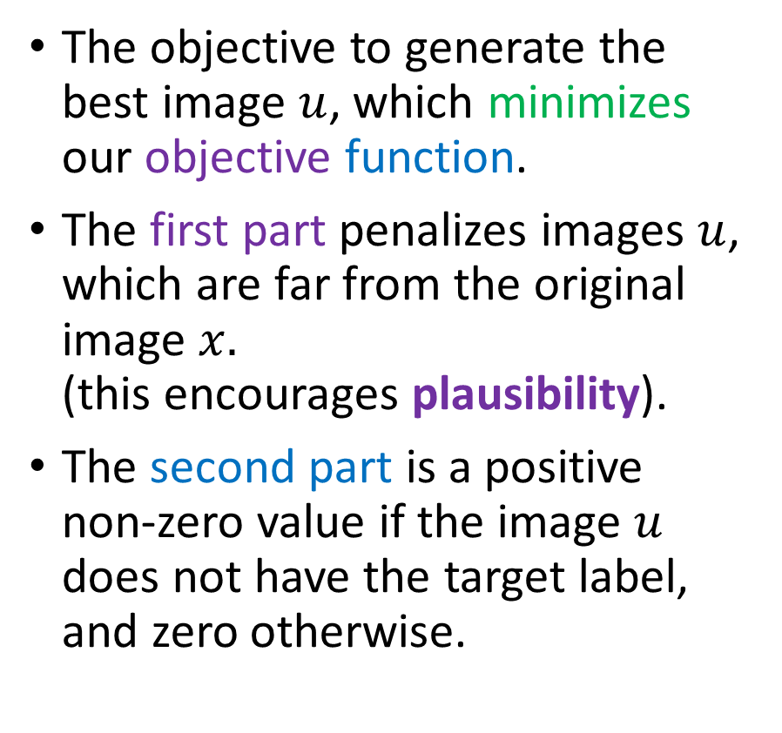
Carlini-Wagner optimization
Objective: generate a sample $\tilde{x}$ with class $\tilde{c}$, from a sample $x$ of class $c$. Do so by solving the unconstrained multi-objective optimization problem below.
$$\min_{u}{ \left({\left\|u−x\right\|}_{2}+α max\left(d\left(u\right), 0\right)\right)}$$
$$with d\left(u\right)=\max_{t≠\tilde{c}} \left(f_{t}\left(u\right)−f_{\tilde{c}}\left(u\right)\right)$$
The objective to generate the best image $u$, which minimizes our objective function.
The first part penalizes images $u$, which are far from the original image $x.$ (this encourages plausibility).
The second part is a positive non-zero value if the image $u$ does not have the target label, and zero otherwise.

Slide 58
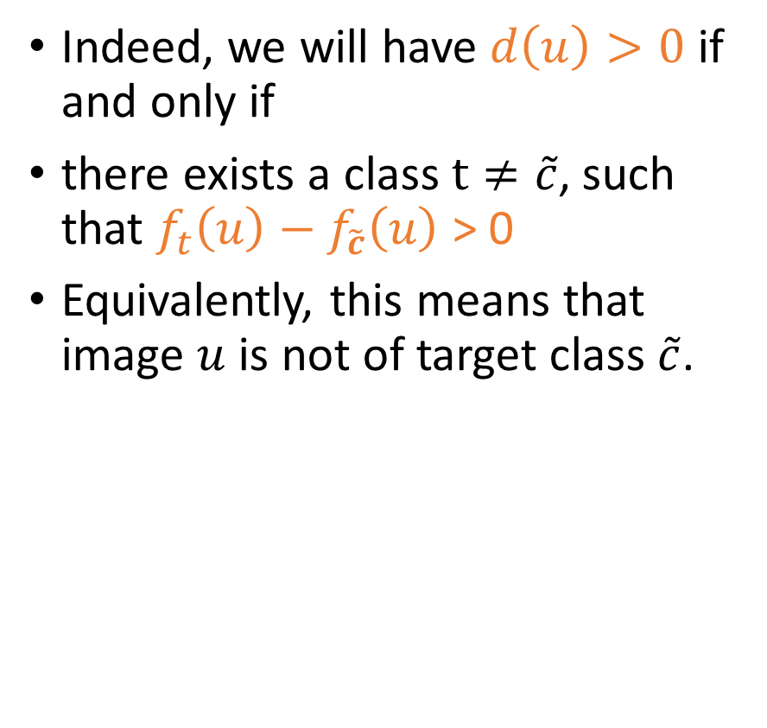
Carlini-Wagner optimization
Objective: generate a sample $\tilde{x}$ with class $\tilde{c}$, from a sample $x$ of class $c$. Do so by solving the unconstrained multi-objective optimization problem below.
$$\min_{u}{ \left({\left\|u−x\right\|}_{2}+α max\left(d\left(u\right), 0\right)\right)}$$
$$with d\left(u\right)=\max_{t≠\tilde{c}} \left(f_{t}\left(u\right)−f_{\tilde{c}}\left(u\right)\right)$$
Indeed, we will have $d\left(u\right)>0$ if and only if
there exists a class $t≠\tilde{c}$, such that $f_{t}\left(u\right)−f_{\tilde{c}}\left(u\right)$ > 0
Equivalently, this means that image $u$ is not of target class $\tilde{c}$.

Slide 59
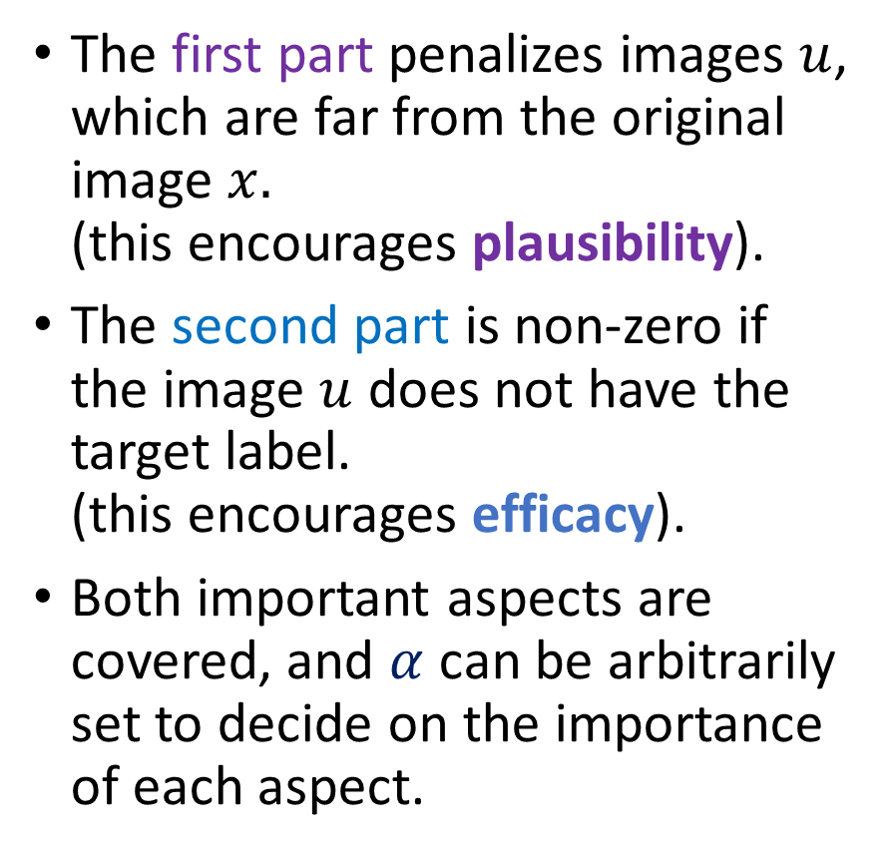
Carlini-Wagner optimization
Objective: generate a sample $\tilde{x}$ with class $\tilde{c}$, from a sample $x$ of class $c$. Do so by solving the unconstrained multi-objective optimization problem below.
$$\min_{u}{ \left({\left\|u−x\right\|}_{2}+α max\left(d\left(u\right), 0\right)\right)}$$
$$with d\left(u\right)=\max_{t≠\tilde{c}} \left(f_{t}\left(u\right)−f_{\tilde{c}}\left(u\right)\right)$$
The first part penalizes images $u$, which are far from the original image $x.$ (this encourages plausibility).
The second part is non-zero if the image $u$ does not have the target label. (this encourages efficacy).
Both important aspects are covered, and $α$ can be arbitrarily set to decide on the importance of each aspect.

Slide 60
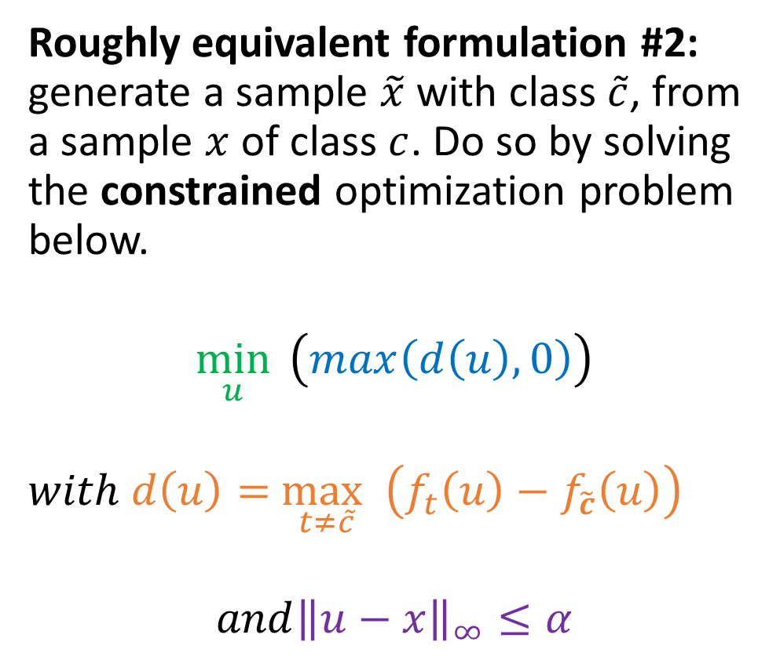
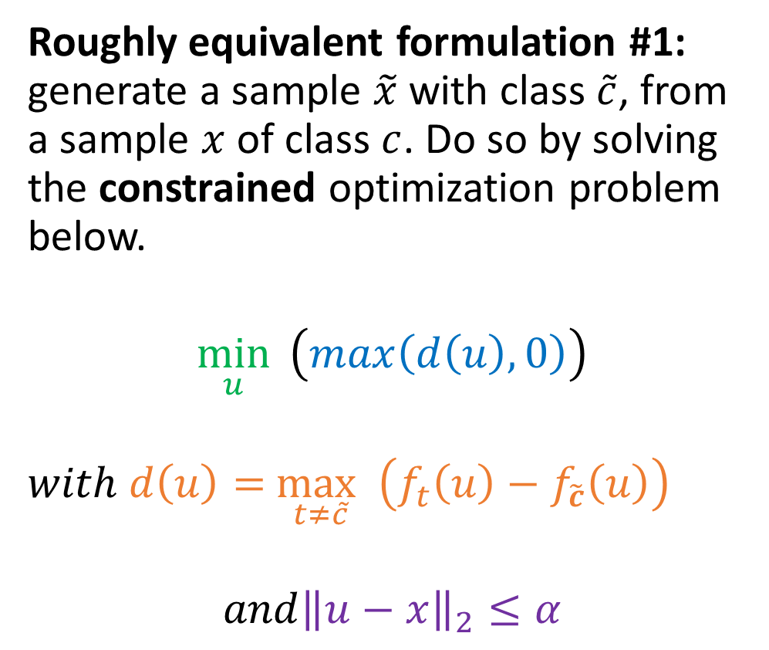
Carlini-Wagner optimization
Roughly equivalent formulation #1: generate a sample $\tilde{x}$ with class $\tilde{c}$, from a sample $x$ of class $c$. Do so by solving the constrained optimization problem below.
$$\min_{u}{ \left(max\left(d\left(u\right), 0\right)\right)}$$ $with d\left(u\right)=$ $\max_{t≠\tilde{c}}$ $\left(f_{t}\left(u\right)−f_{\tilde{c}}\left(u\right)\right)$
$$and{\left\|u−x\right\|}_{2}≤α$$
Roughly equivalent formulation #2: generate a sample $\tilde{x}$ with class $\tilde{c}$, from a sample $x$ of class $c$. Do so by solving the constrained optimization problem below.
$$\min_{u}{ \left(max\left(d\left(u\right), 0\right)\right)}$$ $with d\left(u\right)=$ $\max_{t≠\tilde{c}}$ $\left(f_{t}\left(u\right)−f_{\tilde{c}}\left(u\right)\right)$
$$and{\left\|u−x\right\|}_{∞}≤α$$

Slide 61
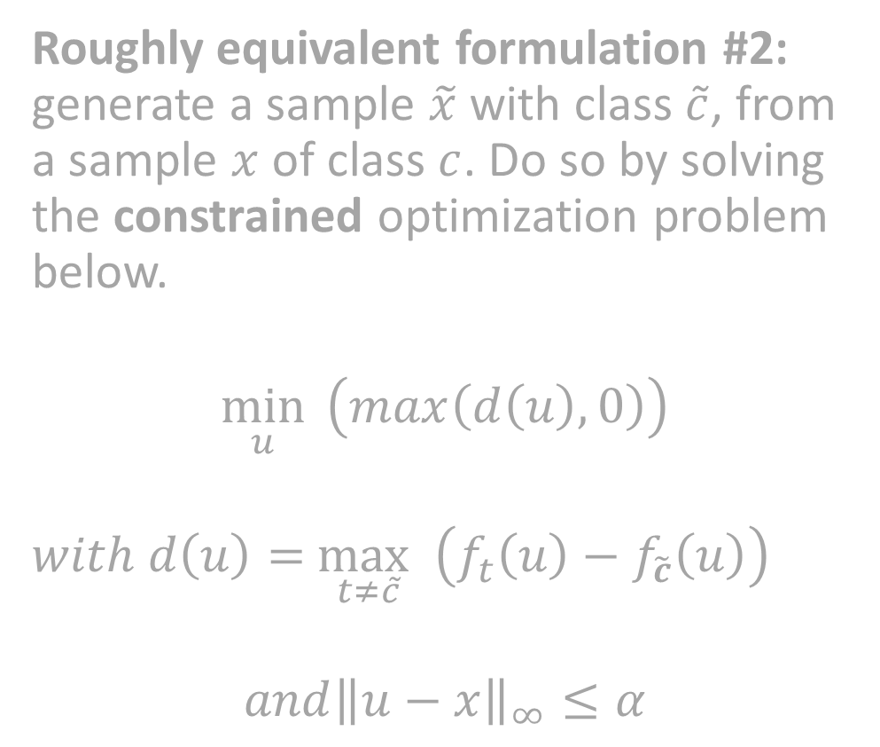
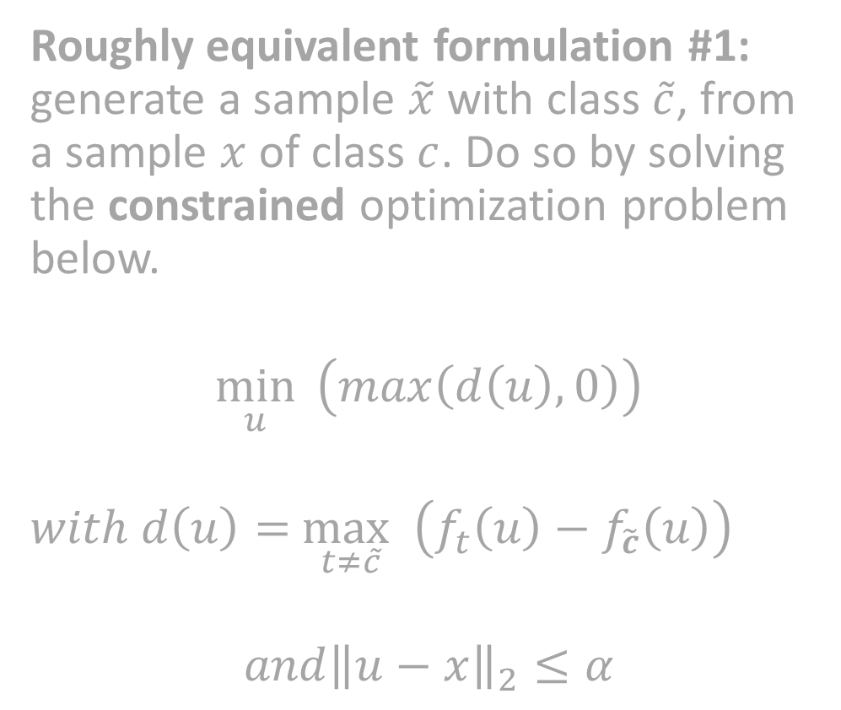
Carlini-Wagner optimization
Roughly equivalent formulation #1: generate a sample $\tilde{x}$ with class $\tilde{c}$, from a sample $x$ of class $c$. Do so by solving the constrained optimization problem below.
$$\min_{u}{ \left(max\left(d\left(u\right), 0\right)\right)}$$ $with d\left(u\right)=$ $\max_{t≠\tilde{c}}$ $\left(f_{t}\left(u\right)−f_{\tilde{c}}\left(u\right)\right)$
$$and{\left\|u−x\right\|}_{2}≤α$$
Roughly equivalent formulation #2: generate a sample $\tilde{x}$ with class $\tilde{c}$, from a sample $x$ of class $c$. Do so by solving the constrained optimization problem below.
$$\min_{u}{ \left(max\left(d\left(u\right), 0\right)\right)}$$ $with d\left(u\right)=$ $\max_{t≠\tilde{c}}$ $\left(f_{t}\left(u\right)−f_{\tilde{c}}\left(u\right)\right)$
$$and{\left\|u−x\right\|}_{∞}≤α$$
Note: Solving these optimization problems can prove to be challenging. Implementation is not necessarily difficult, but cumbersome.
We leave the implementation of these methods out of the scope of this class (Have a look at the papers with code website!)

Slide 62
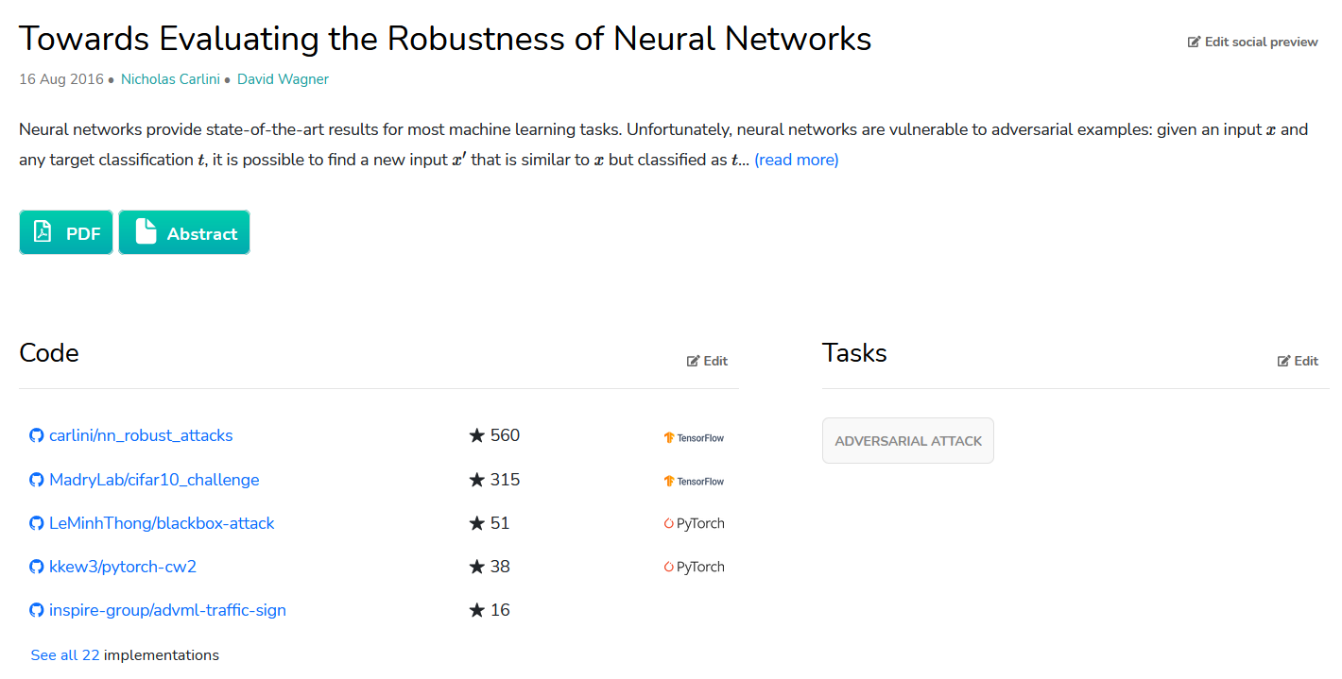
Interested in implementing advanced algos? Look them up on PapersWithCode first!
https://paperswithcode.com/paper/towards-evaluating-the-robustness-of-neural

Slide 63
Black-boxing your model for defense
Definition (Black-boxing defense):
The black-boxing defense refers to the concept of hiding your model parameters to prevent attackers from accessing and using some of these parameters (neither weights, gradients nor logits) in their attacks.

Slide 64
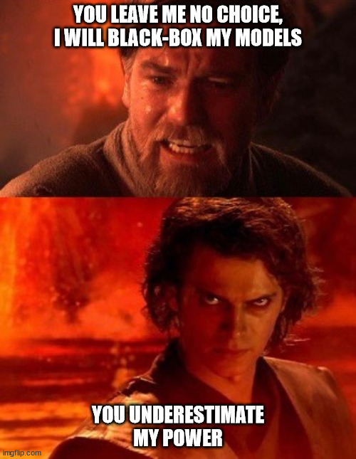
Black-boxing your model for defense
Definition (Black-boxing defense):
The black-boxing defense refers to the concept of hiding your model parameters to prevent attackers from accessing and using some of these parameters (neither weights, gradients nor logits) in their attacks.
The only thing attackers can do is submit inputs to and get outputs from the model.
Defenders

Slide 65
Black-boxing your model for defense
Definition (Black-boxing defense):
The black-boxing defense refers to the concept of hiding your model parameters to prevent attackers from accessing and using some of these parameters (neither weights, gradients nor logits) in their attacks.
The only thing attackers can do is submit inputs to and get outputs from the model.
Defenders
Attackers

Slide 66
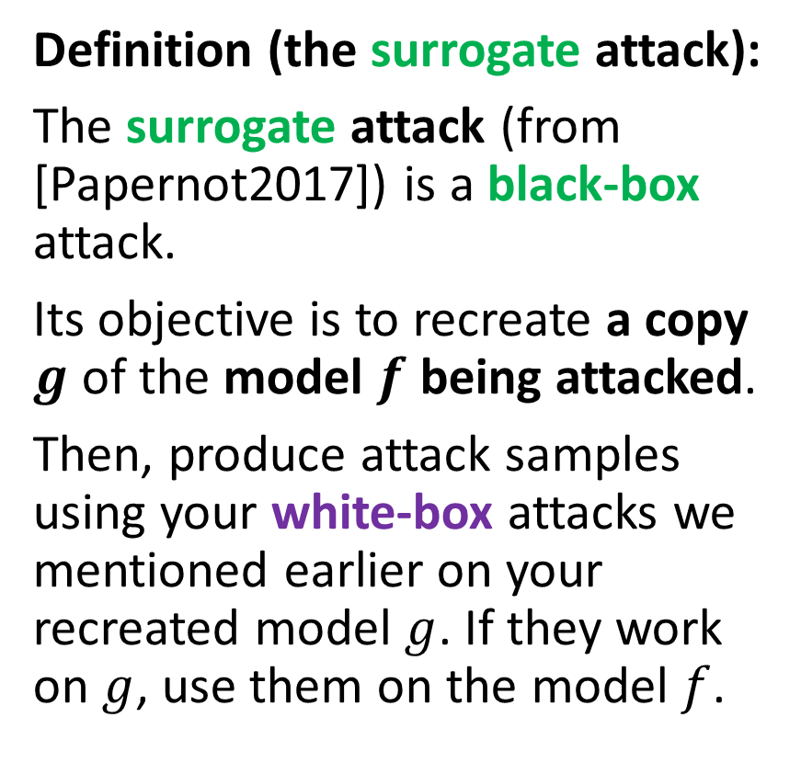
The surrogate attack
Definition (the surrogate attack):
The surrogate attack (from [Papernot2017]) is a black-box attack.
Its objective is to recreate a copy $g$ of the model $f$ being attacked.
Then, produce attack samples using your white-box attacks we mentioned earlier on your recreated model $g$. If they work on $g$, use them on the model $f$.

Slide 67
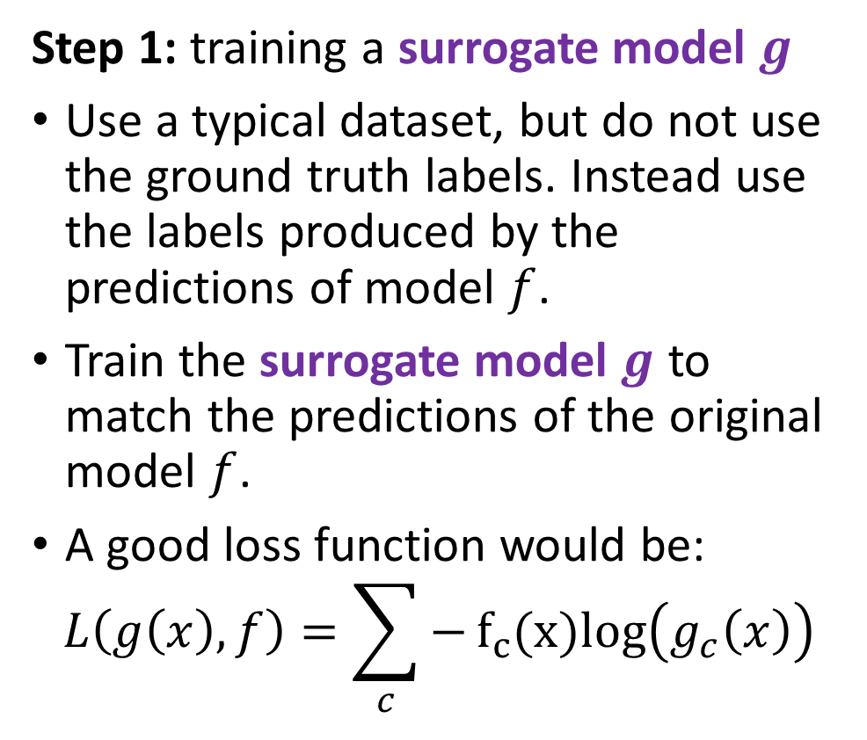
The surrogate attack
Definition (the surrogate attack):
The surrogate attack (from [Papernot2017]) is a black-box attack.
Its objective is to recreate a copy $g$ of the model $f$ being attacked.
Then, produce attack samples using your white-box attacks we mentioned earlier on your recreated model $g$. If they work on $g$, use them on the model $f$.
Step 1: training a surrogate model $g$
Use a typical dataset, but do not use the ground truth labels. Instead use the labels produced by the predictions of model $f$.
Train the surrogate model $g$ to match the predictions of the original model $f$.
A good loss function would be:
$$L\left(g\left(x\right),f\right)=\sum_{c}{−f_{c}(x)log\left(g_{c}\left(x\right)\right)}$$

Slide 68
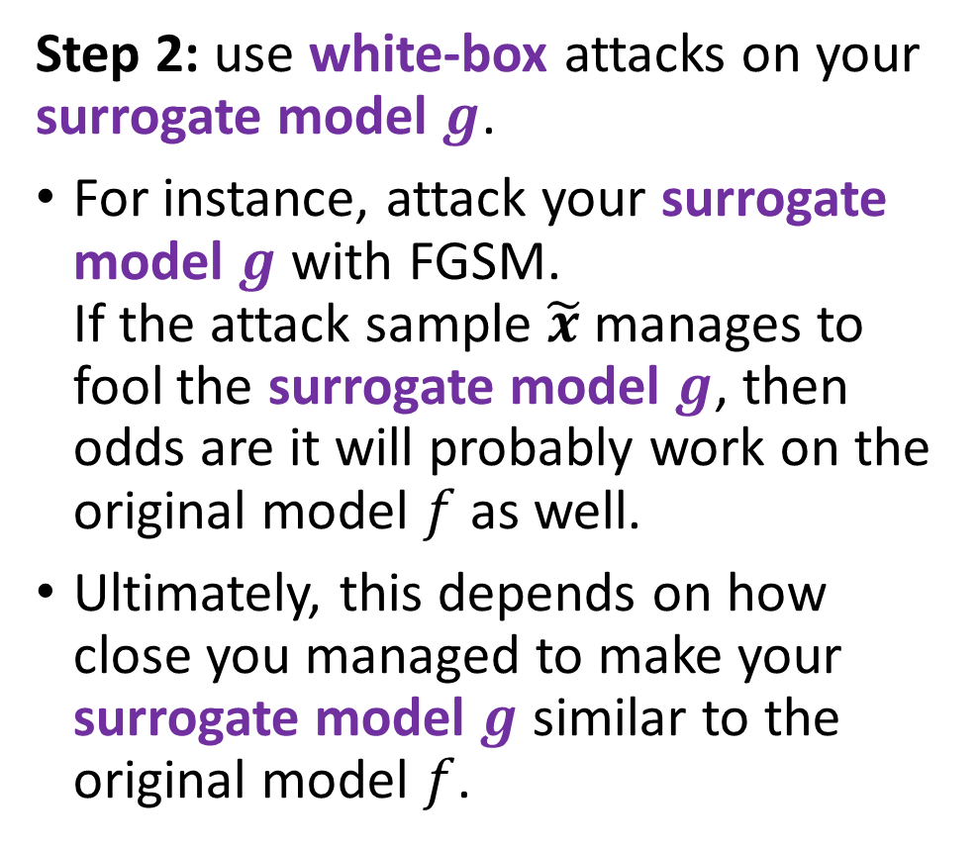
The surrogate attack
Definition (the surrogate attack):
The surrogate attack (from [Papernot2017]) is a black-box attack.
Its objective is to recreate a copy $g$ of the model $f$ being attacked.
Then, produce attack samples using your white-box attacks we mentioned earlier on your recreated model $g$. If they work on $g$, use them on the model $f$.
Step 2: use white-box attacks on your surrogate model $g$.
For instance, attack your surrogate model $g$ with FGSM. If the attack sample $\tilde{x}$ manages to fool the surrogate model $g$, then odds are it will probably work on the original model $f$ as well.
Ultimately, this depends on how close you managed to make your surrogate model $g$ similar to the original model $f$.

Slide 69
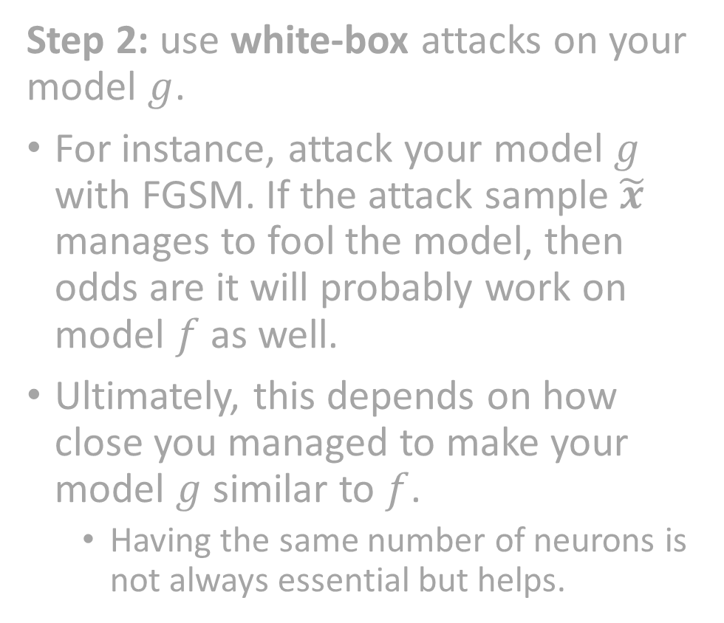
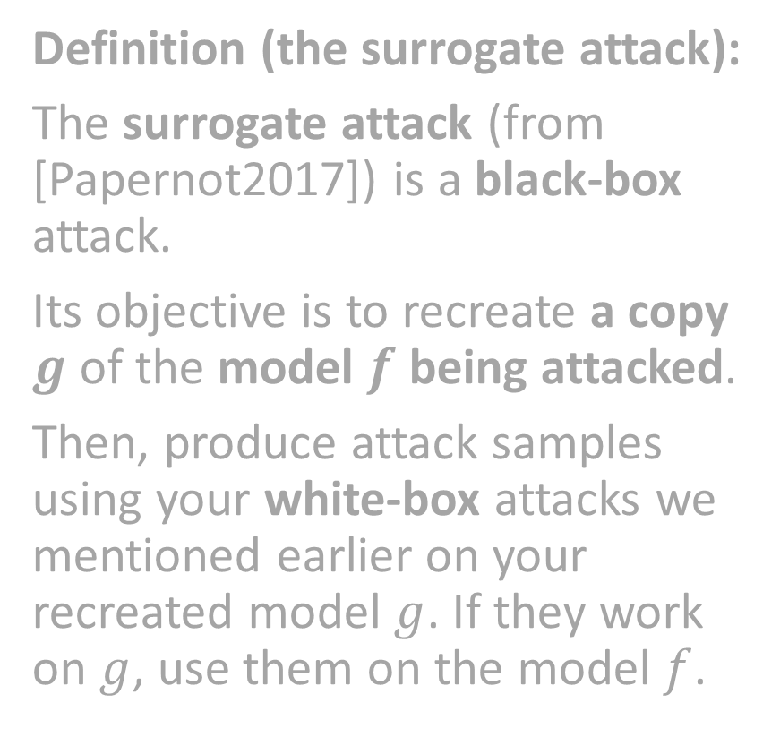
The surrogate attack
Definition (the surrogate attack):
The surrogate attack (from [Papernot2017]) is a black-box attack.
Its objective is to recreate a copy $g$ of the model $f$ being attacked.
Then, produce attack samples using your white-box attacks we mentioned earlier on your recreated model $g$. If they work on $g$, use them on the model $f$.
Step 2: use white-box attacks on your model $g$.
For instance, attack your model $g$ with FGSM. If the attack sample $\tilde{x}$ manages to fool the model, then odds are it will probably work on model $f$ as well.
Ultimately, this depends on how close you managed to make your model $g$ similar to $f$.
Having the same number of neurons is not always essential but helps.
Note: Implementation is not necessarily difficult, but has to be done cautiously. Its guided implementation might be part of the homework for this week! More on this later.

Slide 70
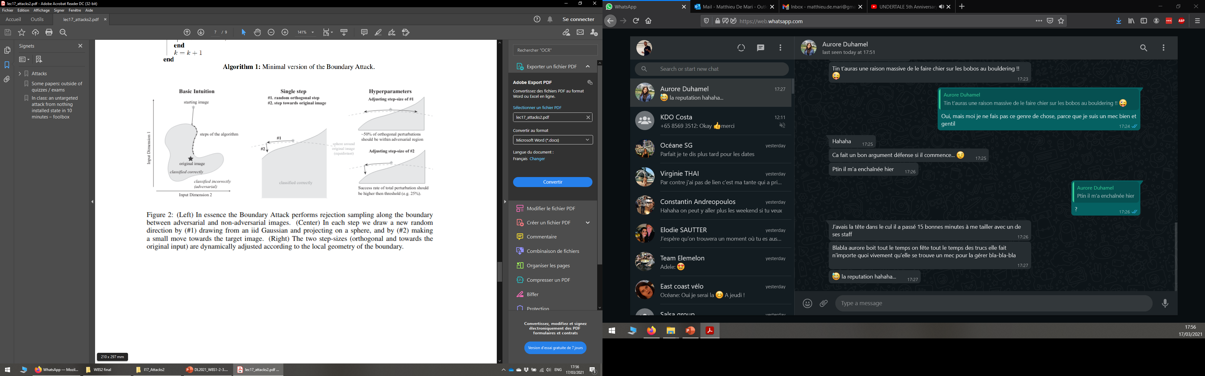
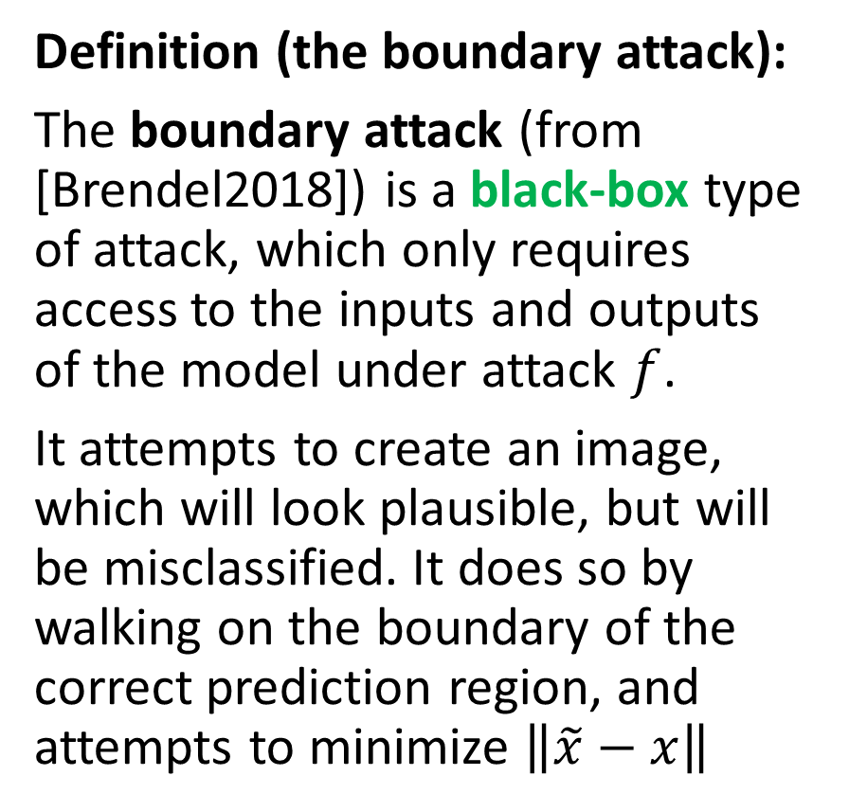
The boundary attack
Definition (the boundary attack):
The boundary attack (from [Brendel2018]) is a black-box type of attack, which only requires access to the inputs and outputs of the model under attack $f$.
It attempts to create an image, which will look plausible, but will be misclassified. It does so by walking on the boundary of the correct prediction region, and attempts to minimize $\left\|\tilde{x}−x\right\|$

Slide 71

The boundary attack
Step 1: Start with a non-adversarial image $x$ (does not have to belong in the original dataset), which is correctly predicted as $c$.
Make another image $x_{0}$, by (heavily) noising your original image $x$.
This image $x_{0}$ should be misclassified.

Slide 72

The boundary attack
Step 2: modify your image $x_{n}$ for instance by using random noising, with low amplitude.
If the new image $x_{n+1}$ is incorrectly classified and verifies $\left\|x_{n+1}−x\right\|≤\left\|x_{n}−x\right\|$, then keep $x_{n+1}.$

Slide 73

The boundary attack
Step 2: modify your image $x_{n}$ for instance by using random noising, with low amplitude.
If the new image $x_{n+1}$ is incorrectly classified and verifies $\left\|x_{n+1}−x\right\|≤\left\|x_{n}−x\right\|$, then keep $x_{n+1}.$
Otherwise reuse the previous image, i.e. $x_{n+1}=x_{n}$.

Slide 74

The boundary attack
Step 2: modify your image $x_{n}$ for instance by using random noising, with low amplitude.
If the new image $x_{n+1}$ is incorrectly classified and verifies $\left\|x_{n+1}−x\right\|≤\left\|x_{n}−x\right\|$, then keep $x_{n+1}.$
Otherwise reuse the previous image, i.e. $x_{n+1}=x_{n}$.
Step 3: repeat step 2, until a maximal number of iterations $N$ is reached.

Slide 75
The boundary attack
Definition (the boundary attack):
The boundary attack (from [Brendel2018]) is a black-box type of attack, which only requires access to the inputs and outputs of the model under attack $f$.
It attempts to create an image, which will look plausible, but will be misclassified. It does so by walking on the boundary of the correct prediction region, and attempts to minimize $\left\|\tilde{x}−x\right\|$

Slide 76

The boundary attack
Definition (the boundary attack):
The boundary attack (from [Brendel2018]) is a black-box type of attack, which only requires access to the inputs and outputs of the model under attack $f$.
It attempts to create an image, which will look plausible, but will be misclassified. It does so by walking on the boundary of the correct prediction region, and attempts to minimize $\left\|\tilde{x}−x\right\|$
Step 3: repeat step 2, until a maximal number of iterations $N$ is reached.

Slide 77


The boundary attack
Definition (the boundary attack):
The boundary attack (from [Brendel2018]) is a black-box type of attack, which only requires access to the inputs and outputs of the model under attack $f$.
It attempts to create an image, which will look plausible, but will be misclassified. It does so by walking on the boundary of the correct prediction region, and attempts to minimize $\left\|\tilde{x}−x\right\|$
Additional notes
You can progressively decrease the noise amplitude when generating $x_{n+1}$from $x_{n}$(in a similar fashion as with the learning rate scheduling).
Add an extra condition, being that your $x_{n}$ must be of a certain target class $\tilde{c}$ to make it a targeted attack.

Slide 78

The boundary attack
Definition (the boundary attack):
The boundary attack (from [Brendel2018]) is a black-box type of attack, which only requires access to the inputs and outputs of the model under attack $f$.
It attempts to create an image, which will look plausible, but will be misclassified. It does so by walking on the boundary of the correct prediction region, and attempts to minimize $\left\|\tilde{x}−x\right\|$
Additional notes
More advanced methods may even try and guess the local geometry of the boundary to make better iterations on the $x_{n}$ images.

Slide 79

The boundary attack in action

Slide 80
The boundary attack in action
Note: Implementation is not necessarily difficult, but cumbersome.
We leave the implementation of these methods out of the scope of this class (Have a look at the papers with code website!)

Slide 81
Black-boxing your model for defense (v2.0!).
Definition (Black-boxing defense, version 2.0!):
The black-boxing defense refers to the concept of hiding your model parameters to prevent attackers from accessing and using some of these parameters (neither weights, gradients nor logits) in their attacks.
The only thing attackers can do is submit inputs and get outputs from the model.
To make the model as black as possible, we can forbid the attacker from even ACCESSING THE MODEL!

Slide 82
Defending by ensemble-ing your model
Definition (The ensemble defense):
The ensemble defense refers to the concept of using multiple models to prevent attackers from making your classifier malfunction.
Each model is trained with a different initialization, hence leading to different weights, gradients, etc.
During testing, each image is passed to each different model, and a list of predictions is obtained (one for each model). The label, which appears the most often is the one returned by our ensemble classifier.
This makes the life of attackers extra difficult, as they have to successfully attack multiple models, with the same sample to make the prediction wrong.

Slide 83

Defending by ensemble-ing your model

Slide 84
Defending by ensemble-ing your model
Attack sample might have made this first model malfunction, but others might remain unaffected! (Final decision is still class 2)

Slide 85
Maximal defense
Nothing more defenders can really do at this point. They have kept their model secret and “ensembled” it.
The attackers only know that the defender has a model, which is trying to accomplish a certain task, but have no access to it.
Defenders have even used multiple instances of the model to get an ensemble classifier.
This covers for attacks that would make one model malfunction.
Attackers obviously lost, right?

Slide 86
On the transferability of attacks
Well… Yes and no.
While it may seem very difficult to make an ensemble, hidden model malfunction…
Recent papers have shown that attacks might be transferable [Liu2017].
Note: this is what we exploited for our surrogate attack, in the first place.
Unfortunately, this means an attack, which makes a certain facial recognition algorithm fail, has great chances to make another mode, even different, fail as well.
And even more true for models within a same ensemble.

Slide 87
Conclusion (W8S3)
Training and attacking a model seem to be the two faces of a same coin.
Being able to do one, unfortunately exposes your to the second one.
Both attackers and defenders have many options up their sleeve. But attackers seem to have a clear advantage.
Attackers are able to exploit
Intrinsic information from models.
But more importantly, fundamental limits of neural networks.
It is a very active research field, with many more advanced concepts, for obvious reasons, as any “sensitive” application will require some kind of defense.

Slide 88
Learn more about these topics
[Madry2017] Madry et al., “Towards Deep Learning Models Resistant to Adversarial Attacks”, 2017 https://arxiv.org/abs/1706.06083
[Papernot2015] Papernot et al., “Distillation as a Defense to Adversarial Perturbations against Deep Neural Networks”, 2015 https://arxiv.org/abs/1511.04508
[Dong2017] Dong et al., “Boosting Adversarial Attacks with Momentum”, 2017. https://arxiv.org/abs/1710.06081
[Carlini2017] Carlini and Wagner, “Towards Evaluating the Robustness of Neural Networks”, 2017. https://arxiv.org/abs/1608.04644

Slide 89
Learn more about these topics
[Papernot2017] Papernot et al., “Practical Black-Box Attacks against Machine Learning”, 2017. https://arxiv.org/abs/1602.02697
[Brendel2018] Brendel et al., “Decision-Based Adversarial Attacks: Reliable Attacks Against Black-Box Machine Learning Models”, 2018. https://arxiv.org/abs/1712.04248
[Liu2017] Liu et al., “Delving into Transferable Adversarial Examples and Black-box Attacks”, 2017. https://arxiv.org/abs/1611.02770

Slide 90
Interested in implementing advanced algos? Look them up on PapersWithCode first!
https://paperswithcode.com/paper/towards-evaluating-the-robustness-of-neural

Slide 91
Learn more about these topics
Out of class, for those of you who are curious
[Medium1] On the ongoing race of coming up with new attacks. https://medium.com/mlreview/the-intuition-behind-adversarial-attacks-on-neural-networks-71fdd427a33b
[Medium2]On why security systems using deep learning are potentially under threat. https://medium.com/@chami.soufiane/security-threats-against-machine-learning-based-systems-a-real-concern-2515115c88e4

Slide 92
Learn more about these topics
Out of class, for those of you who are curious
[YTB1] Generating adversarial patches against YOLOv2, a.k.a. printing patterns to fool AIs and become invisible. https://www.youtube.com/watch?v=MIbFvK2S9g8
[Stanford] Stanford lecture, by Ian Goodfellow @ Stanford on attacks and defense mechanisms for Neural Networks (long!) https://www.youtube.com/watch?v=CIfsB_EYsVI

Slide 93
Learn more about these topics
More fun stuff
[Eykolt2018] Eykolt et al. “Robust Physical-World Attacks on Deep Learning Models”, 2018. Printing stickers to put on your tee-shirts to fool facial recognition systems. https://arxiv.org/abs/1707.08945
[Moosavi-Dezfooli2016] Moosavi-Dezfooli et al., “DeepFool: a simple and accurate method to fool deep neural networks”, 2016. A toolbox with previously mentioned attacks and more advanced attacks. https://arxiv.org/abs/1511.04599
[Athalye2018] Athalye et al., “Synthesizing Robust Adversarial Examples”, 2018. 3D printing misclassified stuff. https://arxiv.org/abs/1707.07397

Slide 94
Learn more about these topics
Tracking important names (Track their works and follow them on Scholar, Twitter, or whatever works for you!)
Aleksander Madry: Professor at MIT, Director of the MIT Center for Deployable Machine Learning and a Faculty Co-Lead of the MIT AI Policy Forum. http://madry-lab.ml/ https://people.csail.mit.edu/madry/ https://scholar.google.ch/citations?user=SupjsEUAAAAJ&hl=en Nicolas Papernot: Assistant Professor at University of Toronto. https://www.papernot.fr https://scholar.google.com/citations?user=cGxq0cMAAAAJ&hl=en

Slide 95
Learn more about these topics
Tracking important names (Track their works and follow them on Scholar, Twitter, or whatever works for you!)
Nicholas Carlini: Research Scientist at Google Brain. https://nicholas.carlini.com https://scholar.google.com/citations?user=q4qDvAoAAAAJ&hl=en
David Wagner: Professor at UC Berkeley. https://people.eecs.berkeley.edu/~daw/papers https://scholar.google.com/citations?user=67kghxAAAAAJ&hl=en

